Slide 1
Updates to the 2025 Kentucky Housing Task Force
June 30, 2025
Presented by Kentucky Housing Corporation
Winston Miller, CEO/Executive Director
Wendy K. Smith, Deputy Executive Director, Housing Programs
Notes:
Introduction
Thank co-chairs and task force for inviting KHC to again present.
Over the past 3+ years, Kentucky’s need for more housing supply across all counties and all income levels has risen to become the most critical housing issue for the Commonwealth.
Commend the task force for recognizing the urgency of the issue and for reconvening to take action.

Slide 2
KHC Aims to be an ongoing resource for the Housing Task Force
Focus of today’s presentation:
Updates on the Housing Landscape
Current Resources that Support Housing Development in Kentucky
What KHC recommends the Task Force Focuses on

Slide 3
I. Updates on the Housing Landscape

Slide 4
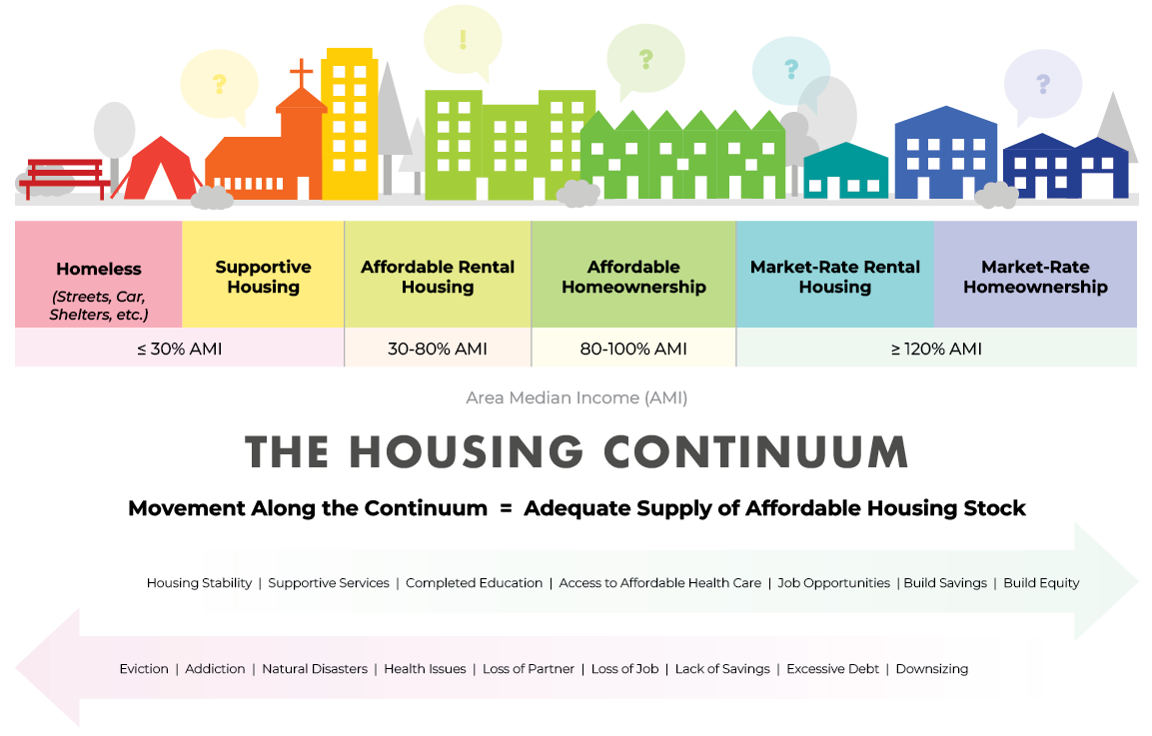
A. Kentucky’s Housing Supply Gap
Notes:
In 2024, KHC commissioned its first-ever Housing Supply Gap Analysis, conducted by the market research firm, Bowen National Research.
The analysis found that Kentucky needs to add over 200,000 units to the Commonwealth.

Slide 5
THE HOUSING CONTINUUM
A healthy market offers a supply of income-aligned options across a range of housing types
<30% Area Median Income | 30%-80% AMI | 80%-120% AMI | 120%+ AMI
<$22,750 | $22,750 -$60,650 | $60,650 -$90,960 | $90,960+
2025 Kentucky Median Family Income for 3-person household as published by HUD.
Notes:
When talking about housing supply gaps, it’s important to think about the housing continuum—or the housing marketplace.
Across Kentucky, households earn varying income and are at varying life stages. These factors lead them to seek housing aligned with their income and lifestyle.
Seniors may seek to downsize. Young families may want more bedrooms in a rental or homeownership option.
While KHC’s programs focus on folks on the middle to left side of the continuum, our programs are losing ground because:
Most all assume there will be enough supply of housing that downpayment assistance or rent assistance will be sufficient for them to rent or buy a home aligned with their income.
This is less and less the case.
We are seeing moderate and low income households compete for housing with middle-income households.
When there aren’t enough units, Kentuckians with the lowest incomes as well as a disability, prior eviction, bad credit, prior conviction, addiction struggles and so on are the most at risk to be priced out of reasonable rental options.
In the worst cases, this results in homelessness.

Slide 6
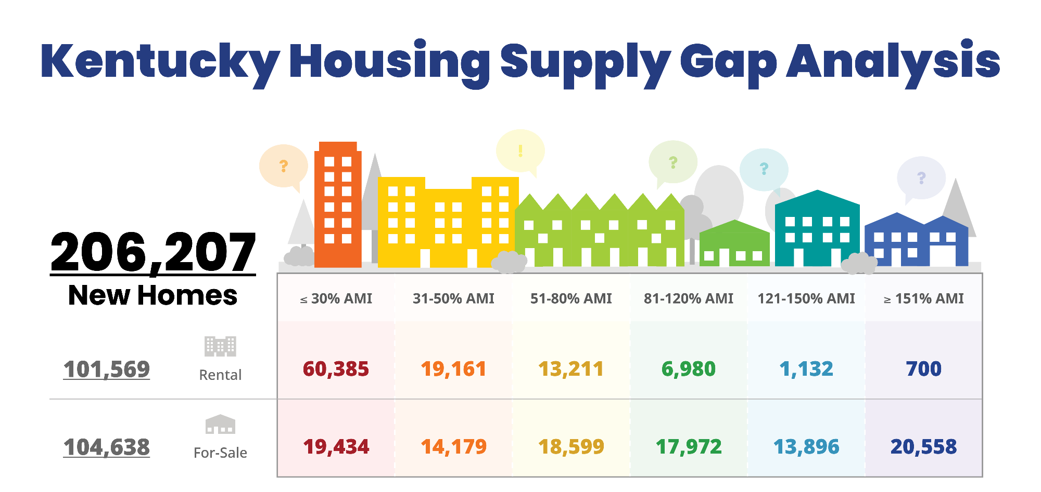

2024 Current Gap
Notes:
The current 2024 supply gap totals 206,000:
There is a similar gap for homeownership & rental across all income ranges
The need for >101K rental units is concentrated across low-income households—those earning 80% of area median income and below.
The need for over >104K homeownership units is spread across all income ranges.

Slide 7
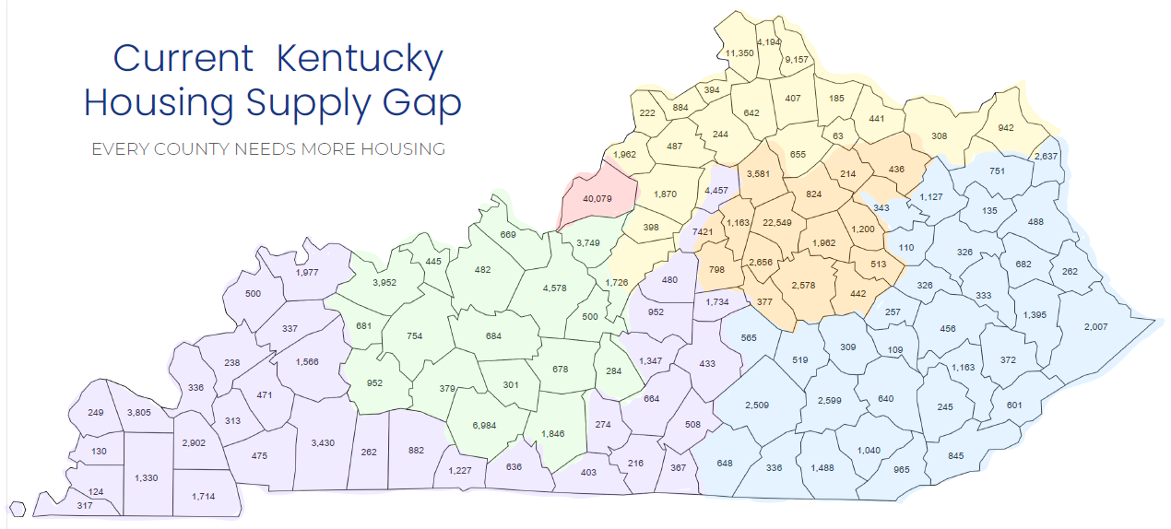
KY Housing Supply Gap
Every county needs more housing
Notes:
The 206,000-unit supply gap is distributed across all counties.
While some of these numbers appear small, they often represent a significant share of the county’s existing housing.

Slide 8
Many organizations have sought presentations on the housing supply gap
KY League of Cities KY Association of Counties KY County Judge Executive Assoc. KY Realtors Association Mortgage Bankers KY Chamber of Commerce Homebuilders Association of KY KY Economic Development Cabinet I-71 Economic Development Alliance EKY Leadership Foundation DLG Local Issues Conference | KY Workforce Investment Board Conference of KY PVAs KY USDA State Office Council of Area Development Districts Baren River ADD Northern KY ADD Lincoln Trail ADD Lake Cumberland ADD Individual Cities & Counties Homeless Shelter & Service Providers Leadership Louisville Bingham Scholars
Notes:
KHC has be overwhelmed by the range of new partners wanting presentations and discussions around the Housing Supply Gap.
Most of the stakeholder on this list do not work day-to-day with KHC and do not utilize our funding and financing.
Yet, housing is a top issue for them.

Slide 9
Kentucky’s Housing Supply Gap
2024 Gap: 206,207 units
2029 Gap: 287,120 units

Slide 10
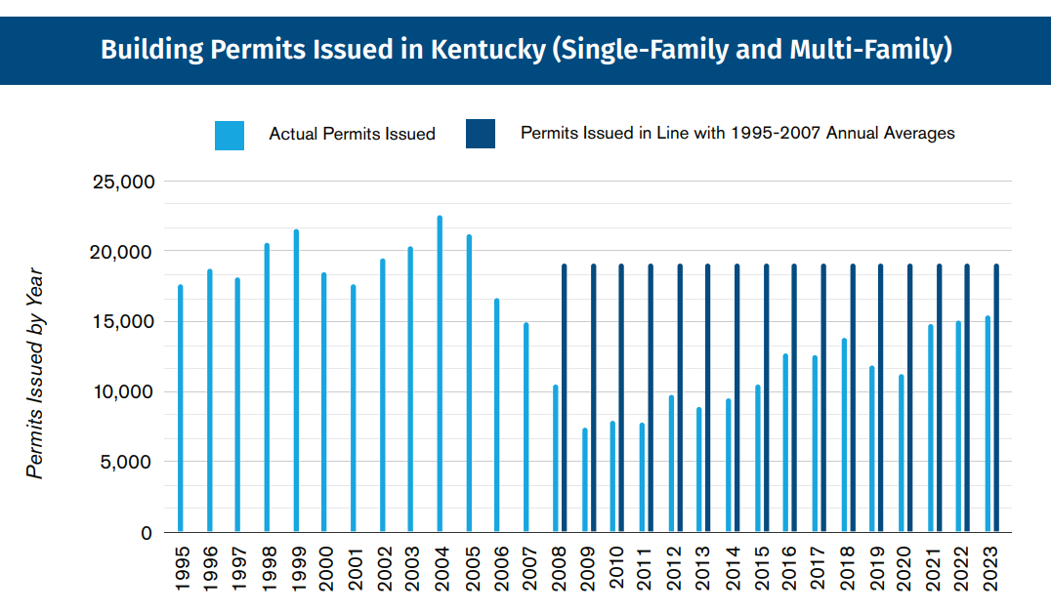

Notes:
While many factors contribute to Kentucky’s housing supply gap one cause is dominant:
The 2008 Housing Crisis and Great Recession dramatically decreased housing production—resulting in chronic underconstruction.
For 17 years, we have built far fewer units than we used to on average.

Slide 11
Units that didn’t get built.
Units that didn’t get built.

Slide 12
B. Housing Market Dynamics

Slide 13
Housing Market Dynamics
U.S. supply gap estimated from 1.5M to 3.7M units
Destruction of units due to natural disasters
Heightened financial stress on homeowners and landlords
Pressure on construction costs due to tariffs and workforce shortages
Pressure on construction costs due to tariffs and workforce shortages
Home prices and rent increases far outpace income
Notes:
Homeownership is increasing costly for existing owners & out of reach to new buyers due to:
- Insufficient supply
- Higher interest rates
- Increasing property taxes
- Escalating insurance costs

Slide 14
Housing Market Dynamics continued
Higher interest rates
Increasing property taxes
Escalating insurance costs
Increasing housing cost burdens
Homelessness is increasing across the nation
Diminishing federal support + possibility of drastic federal cuts
Looming possibility of economic downturn

Slide 15
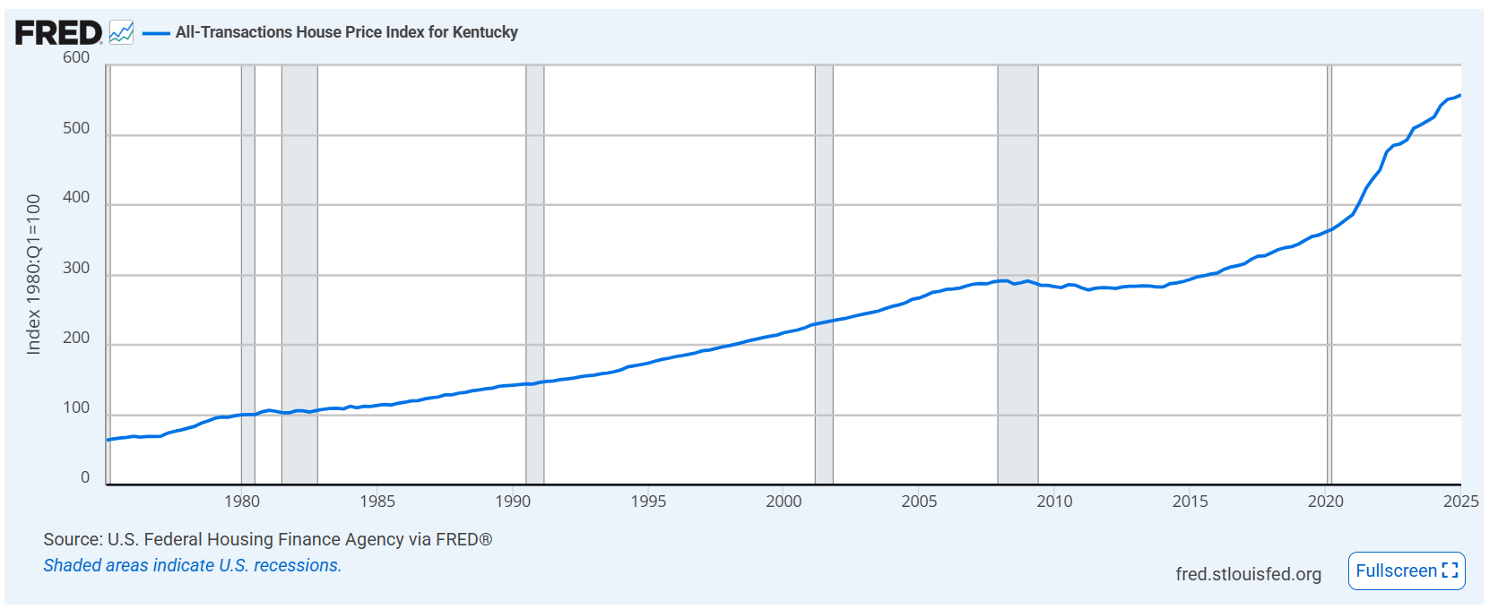
House Price Index for Kentucky
U.S. Federal Housing Finance Agency, All-Transactions House Price Index for Kentucky retrieved Federal Reserve Bank of St. Louis; https://fred.stlouisfed.org/series/KYSTHPI.

Slide 16
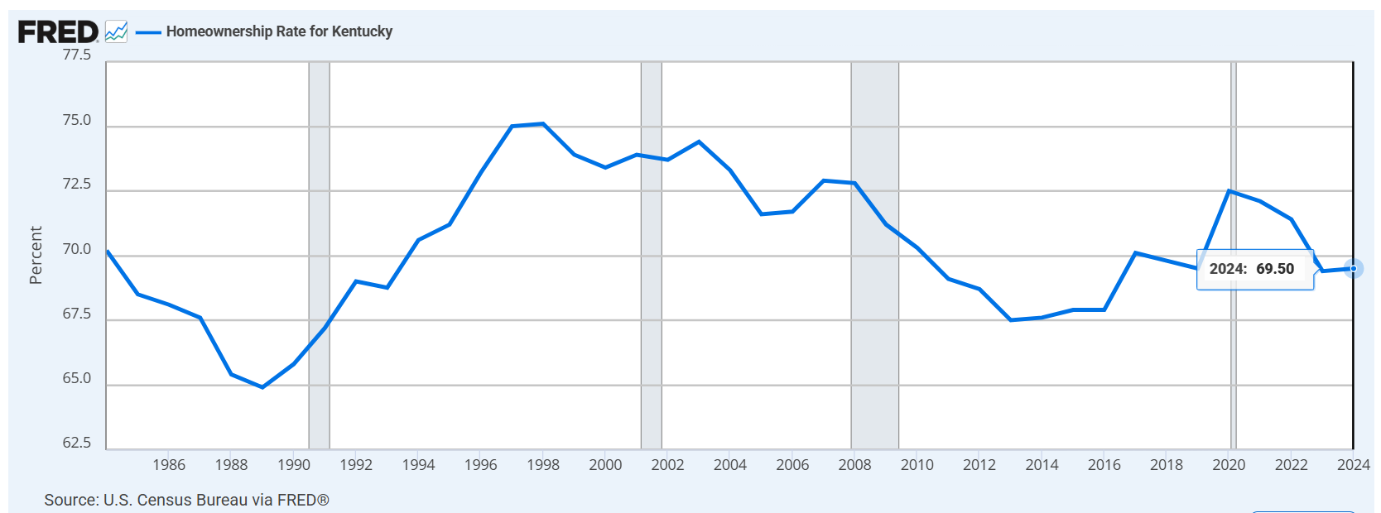
KY homeownership rates have declined
https://fred.stlouisfed.org/series/KYHOWN

Slide 17
➔ U.S. Housing starts are NOT projected to accelerate in the next few years

Slide 18


Housing Starts (000)
Housing Economics PLUS | NAHB
Notes:
This NAHB chart shows actual and projected housing starts through 2027.
Blue is all housing starts
Orange is single-family homes
Green is multifamily
What you can see is that no significant increase is projected—meaning the national housing supply gap will persist.

Slide 19
Units that didn’t get built.
Units that didn’t get built.

Slide 20
➔ Housing market dynamics are resulting in increased homelessness in Kentucky
➔ 2023-2024: 10% Increase
➔ 2024-2025: 11% Increase
Notes:
Each January, homelessness service and shelter providers conduct a Point in Time count of people in shelters and on the streets/tents/cars.
It’s an imperfect count—not exact #s.
But, the trends are representative of what’s happening in Kentucky.
Since 2023 rates of homelessness are increasing.
From 2023-2024 year we saw a 10% increase in homelessness in KY
From 2024-2025 year we saw an 11% increase in homelessness in KY
We view this as an indicator of the lack of housing supply for extremely poor and challenged Kentuckians.

Slide 21
    Higher average housing costs.
    Kentuckians spending too much on monthly housing costs.
    Lower homeownership rates.
    Too little workforce housing.
    Increased household instability.
    More homeless Kentuckians.
Impact of Kentucky’s Housing Supply Shortage
The housing supply shortage
is Kentucky’s most urgent housing issue.

Slide 22
C. Federal Budget Uncertainty

Slide 23
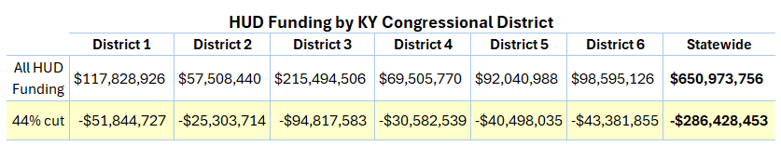
White House FY26 Budget Proposal
Impacts on Housing In Kentucky
Calls for a 44% cut to housing and homeless programs compared to FY25.
= Estimated $286M reduction in HUD funds flowing to KY:
Source: www.urban.org/data-tools/federal-housing-funding-tracker
Notes:
White House FY26 Budget Proposal
Impacts of Kentucky Losing $286M in HUD Funds
43% cut to essential rental assistance programs, impacting private landlords and public housing authorities.
Elimination of CDBG-funded projects for infrastructure, public facilities, etc.
Elimination of HOME Program funds that build homes and apartments.
Loss of an estimated $11M in homelessness funding
Financial failure of properties financed to serve low-income Kentuckians based on an assumption of rental assistance.
Increased housing instability.
Increase homelessness

Slide 24
II. Existing Resources Supporting Housing Supply in Kentucky

Slide 25
A. Federal & State Programs Supporting Housing

Slide 26
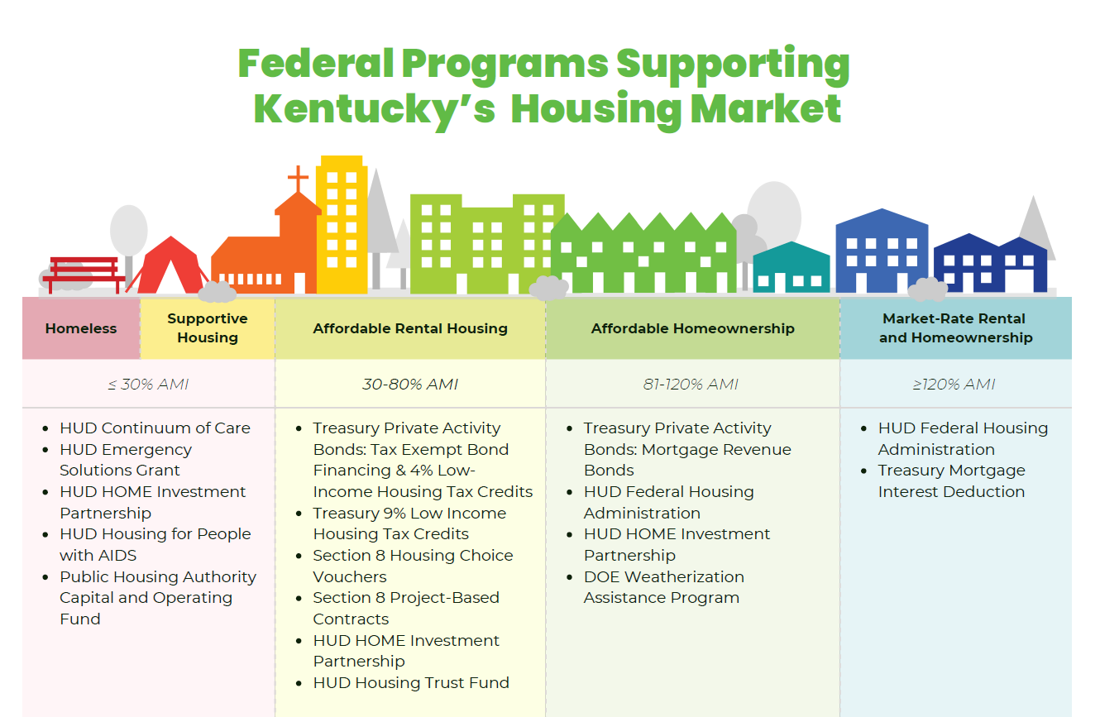
Federal Programs Supporting Housing
Community Development Block Grants can support infrastructure & disaster recovery.
Private lending/financing plays a role in most project types.
Notes:
Federal funding to support and develop affordable housing has remained relatively flat & is expected to decrease.
As discussed earlier, the President’s FY26 budget proposes 44% cuts to HUD overall, with many programs listed her being zeroed out.
Furthermore, these programs have been around since prior to 2008 and have not see significant increases in annual funding (excepting the pandemic).
They meant to help specific income ranges and populations but are not geared toward or fund to be market-moving programs that will close the current housing supply gap.

Slide 27
Kentucky Programs Supporting Housing
 | KY Affordable Housing Trust Fund $3.8M in FY25
 |  | KY Rural Housing Trust Fund One-time funding: $5M in FY26
 |  |  | KHC Mortgages & Downpayment Assistance 3,700 Homebuyers annually
 |  |  | Ky Dept. of Revenue Mortgage Interest Deduction
Notes:
Kentucky has only a few state-funded programs that support housing.
AHTF
RHTF
KHC Mortgages & DPA
State mortgage interest deduction
Again, none of these was created to be market-moving.

Slide 28
B. Missing Resources

Slide 29
➔ Nearly all these resources have been in place since well before the 2008 Housing Crisis.
Funds budgeted & private financing have proved insufficient to spark housing construction to keep up with demand, creating a supply gap that grows larger each year for the foreseeable future.

Slide 30
The top home builder concerns for 2025:
High interest rates (78%)
Buyers expect prices or interest rates will decline if they wait (74%)
Cost/availability of developed lots (65%)
Cost/availability of labor (64%)
Building material prices (64%)
Impact/hook-up/inspection or other fees (58%)
Rising inflation in the U.S. economy (52%)
NAHB Builders’ Top Challenges for 2025

Slide 31
C. Our Fellow States are Taking Action

Slide 32
States are Accelerating Housing Supply
Establishing Ambitious Production Goals
Land Use & Zoning Incentives/Mandates
Funding & Financing:
Tax Credits
Tax Abatement
Housing Infrastructure
Housing Development

Slide 33
States are Creating Ambitious Housing Goals
State | Publicly Established Housing Goal
Utah | 35,000 starter homes costing <$300,000 by 2028
Michigan | 115,000 homes by 2026
Rhode Island | 15,000 new homes within 5 years
New York | 100,000 homes within five years
Oregon | 36,000 new homes per year
Notes:
Many states are establishing public goals around housing production.
This is a way to recognize the issue and marshal attention and resources to address it.

Slide 34
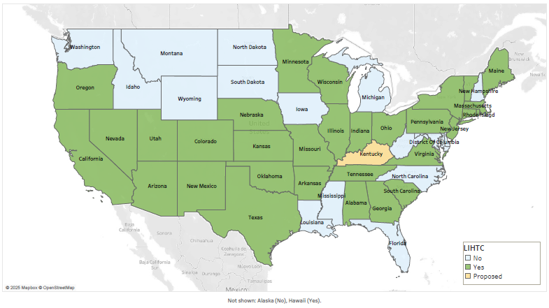
Most States Have Created State Tax Credits for Affordable Rental Development
www.novoco.com/resource-centers/affordable-housing-tax-credits/state-lihtc-program-descriptions
Notes:
A state housing tax credit that mirrors the federal Low Income Housing Tax Credit was proposed last year.
Most States have one.

Slide 35
States are Creating State-Funded Housing Programs
Many have a Revolving Loan Fund component
State | Program | Funding
Oklahoma | Revolving Loan Fund for Rental Housing Development | $63.5M
Indiana | Residential Infrastructure Program | $75M
Indiana Montana | Regional Development, including Housing Acceleration | $1B $225M
Oklahoma, Ohio, Utah | Homebuilding Programs | $100M / $150M / $300M
Oklahoma | Down Payment Assistance | $40M
Georgia, Wisconsin | Workforce Housing Programs | $90M / $375M
Michigan | Employer Assisted Housing Match | $10M (Pilot)

Slide 36

Indiana Residential Infrastructure Fund (RIF)
Will be featured at KHC’s Conference August 2025
$75M for low interest, 20-year loans for infrastructure projects supporting rental or homeownership development in communities with demonstrated need for additional housing inventory based on job growth.
Local governments apply.
Funds installation, replacement, upgrade, or public infrastructure for the support of housing.
Can fund land purchase too.
www.in.gov/ifa/residential-housing-infrastructure-instance-program/
Notes:
Revolving fund
Repayments on first generation of projects are coming back into the fund

Slide 37

Indiana READI Program
Regional Economic Acceleration & Development Initiative
$1 billion for regions collaborating on efforts around:
Quality of Life
• Tourism, arts, culture and community projects
• Family-support initiatives (childcare & healthcare)
• Trails and parks
Quality of Place
• Housing availability and affordability (New & rehabilitated units)
• Growth infrastructure (water, sewer, roads, and utilities)
• Mixed-used developments (residential & commercial)
• Blight Remediation and Redevelopment
Quality of Opportunity
• Infrastructure leading directly to jobs
• Talent supply and education
• Innovation and entrepreneurship
Will be featured at KHC’s Conference August 2025
indianareadi.com
Notes:
READI 1.0 - $500M ARP funds
Mostly grants
READI 2.0 - $500M in state budget
Aim is to revolve some funds, so mix of grants and loans
Match requirement:
1:1 match from local public funding
3:1 match from private and philanthropic sources.
At least 60% of the match should be from private sources.

Slide 38
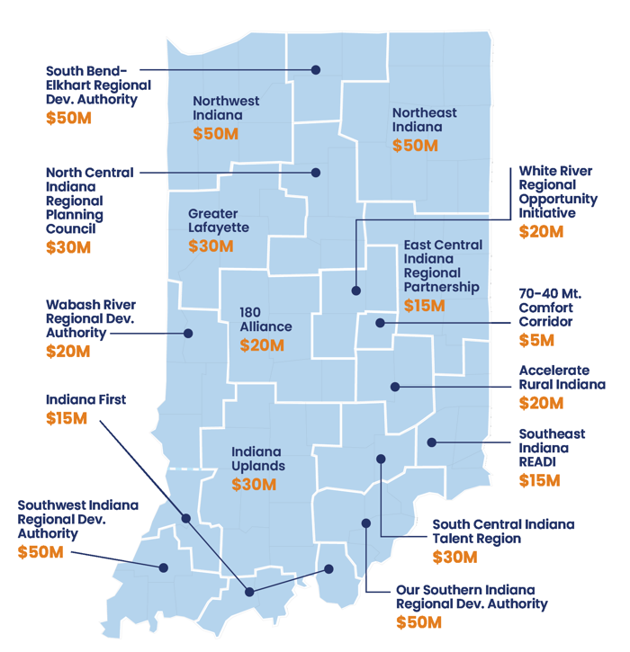
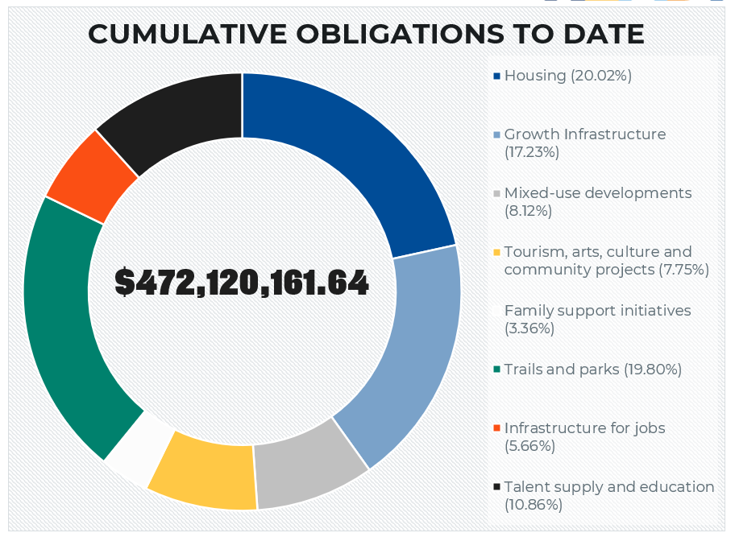
Housing
20%
indianareadi.com

Slide 39
➔ Kentucky may be years behind fellow states in accelerating housing production.

Slide 40
III. Task Force Focus Areas
KHC Recommendations

Slide 41
Items for which partners have advocated:
Affordable Housing Trust Fund
State Housing Tax Credit

Slide 42
➔ Modernize fees that fund the
KY Affordable Housing Trust Fund
Per KRS 64.012:
Of the fees collected by county clerks when real estate documents are recorded:
$6 goes to the AHTF
This amount has remained unchanged since 1992

Slide 43
Year | AHTF Receipts | Change
FY19 | $4,380,000
FY20 | $3,613,000 | -18%
FY21 | $5,844,000 | +62%
FY22 | $5,837,000 | -0.1%
FY23 | $4,416,000 | -24%
FY24 | $3,766,000 | -15%
FY25 | $3,820,000 | +1.4%

Slide 44
States Dedicating More to State AHTFs
Since 1992, Kentucky’s fee has been $6 per recording.
State | Recording Fee For Housing Trust Fund
California, Illinois Massachusetts | $75 per recording
Connecticut | $26 per recording
Ohio | $17 for the first 2 pages; $4 each additional
Oregon | $60 for the first page; $5 each additional
Washington | $99 per recording
West Virginia | $20 per recording
Kentucky | $6 per recording (since 1992)

Slide 45
KY Rural Housing Trust Fund
One-Time Funding Only
Fiscal Year | Geography | Total RHTF Funds
FY24 | Disaster-Impacted Counties: 2021 WKY Tornadoes 2022 EKY Flooding | $10M EKY $10M WKY
FY25 | Any rural area as defined by USDA. | $5M
FY26 |  | $5M

Slide 46
➔ Establish a KY Affordable Housing Tax Credit

Slide 47
RECOMMENDED FOCUS:
Establish flexible resources that accelerate housing production.

Slide 48
➔ Flexible resources will move the market by incentivizing public-private partnerships that accelerate housing production across KY.
➔ Revolving Loan Fund
➔ Economic Development Tools for Housing
➔ Employer-Assisted Housing

Slide 49
➔ The flexibility of state-level funds over federal dollars cannot be overemphasized!
➔ Lower costs
➔ Faster production
➔ Less red tape
Notes:
I often say that every federal dollar has a 50-lb brick tied to it:
Environment review
Davis-bacon wage reporting
Myriad cross-cutting federal regulations and requirements
These all add time and cost to development.

Slide 50
In Closing

Slide 51
    Lower average housing costs.
    Higher homeownership rates.
    More workforce housing.
    Increased household stability.
    Lower eviction rates.
    Fewer homeless Kentuckians.
If Kentucky
had enough housing units, we’d see:

Slide 52
The housing supply shortage is KY’s most urgent housing issue.

Slide 53
ALL OF KY’S 120 COUNTIES NEED MORE RENTAL & FOR-SALE HOMES.

Slide 54
Housing is Key to Our Economy:
Homes are where jobs go to sleep at night.

Slide 55


THANK
YOU
Notes:
Closing Remarks
It is essential to Kentucky’s economy that we catch up on housing acceleration.
Thank those who will participate in KHC’s Conference & reiterate invitation to the entire task force.
KHC is happy to provide more detailed information on any topic covered today and would be happy to meet again with this task force and/or individual members.

Slide 56

KHC Invites Housing Task Force Members to our Annual Conference:
August 20-21, 2025​
(Wednesday & Thursday)
NKY Convention Center Covington, KY
KHC Requests Your Participation Thursday, August 21:
8:30-9:30am | Legislative Update Plenary Panel of KY legislators discussing the Housing Task Force, previous legislation, and the 2026 outlook.
10am- Noon | Breakout Sessions - One features promising Indiana READI & RIF programs that accelerate housing development.

