Slide 1
Notes:
Good morning. I’m Wendy Smith, DED of KHC. I am so pleased to be here today.
I want to thank the member of this task force for inviting KHC to present at your inaugural meeting.

Slide 2
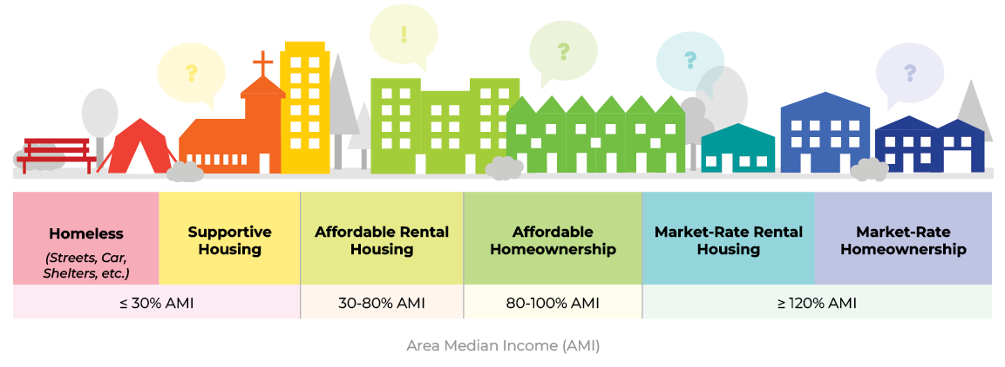
The Housing Continuum
(aka The Housing Market)

Slide 3

Kentucky Chamber &
Homebuilders Association of Kentucky
Housing Report
www.kychamber.com/housing
July 2024
“As the state continues to attract new business investments… housing challenges will intensify, resulting in unsustainable growth and holding back Kentucky’s potential.

Slide 4
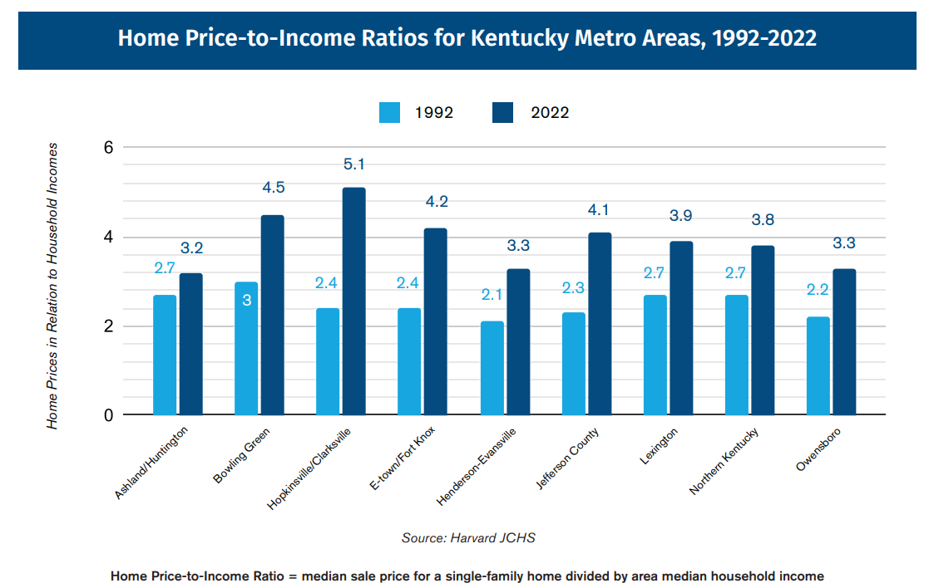
www.kychamber.com/housing
Notes:
The 2022 statewide ratio was 3.9

Slide 5
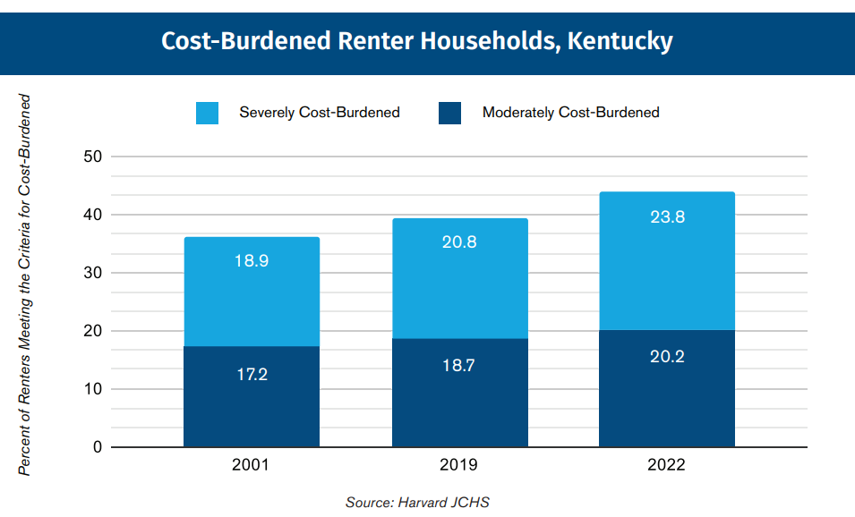
44% of KY Renters are Cost Burdened.
24% are Severely Cost Burdened.
Notes:
In 2022, 44% of KY renters were housing cost-burdened.

Slide 6
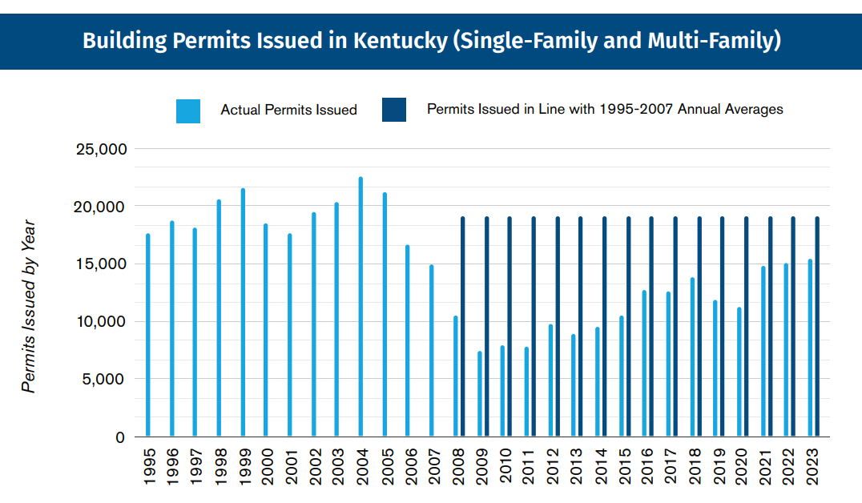
www.kychamber.com/housing

Slide 7
Units that didn’t get built.
Units that didn’t get built.
www.kychamber.com/housing

Slide 8
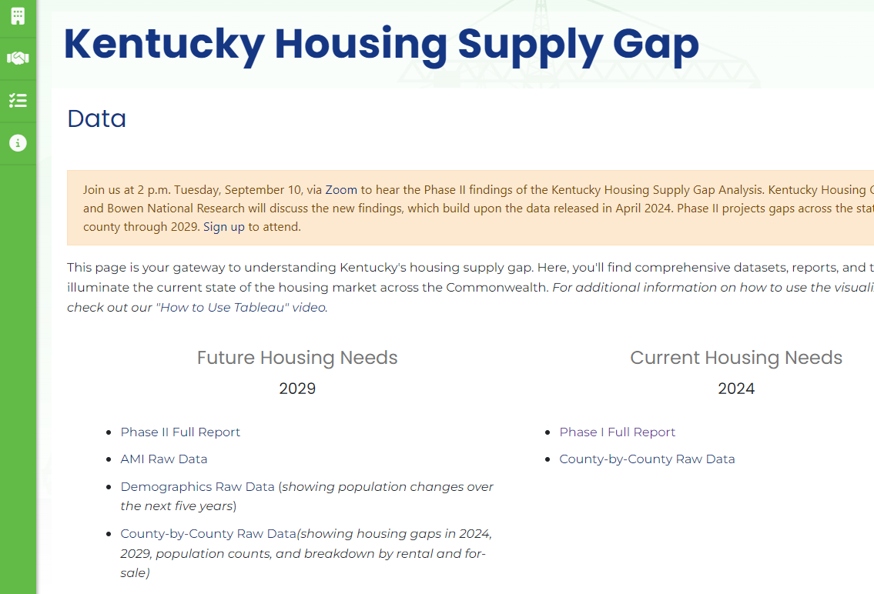
www.kyhousing.org/Data-Library/Housing-Gap-Analysis/Pages/Data.aspx

Slide 9
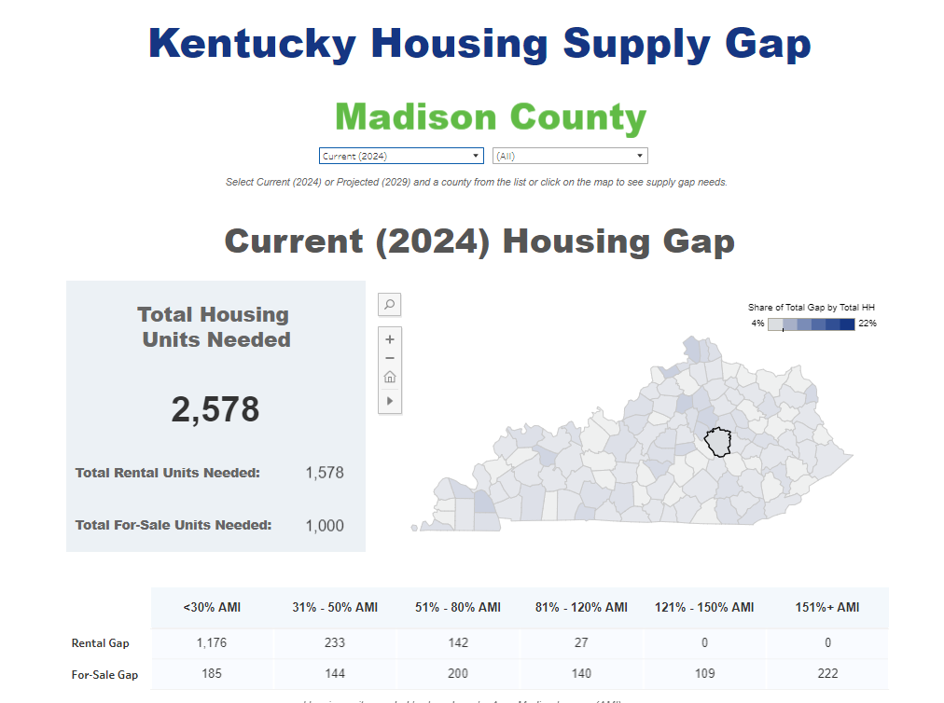

Slide 10
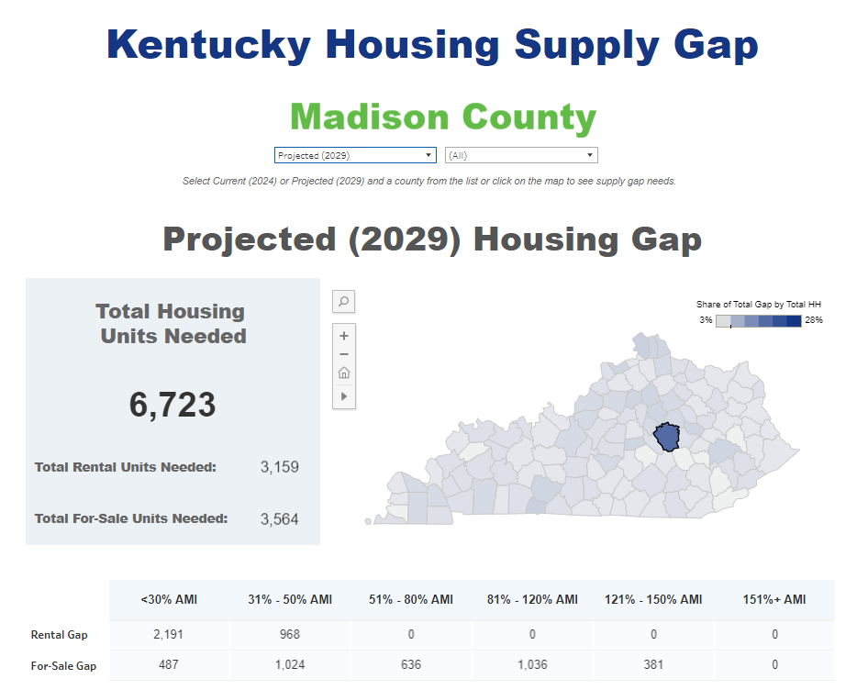

Slide 11
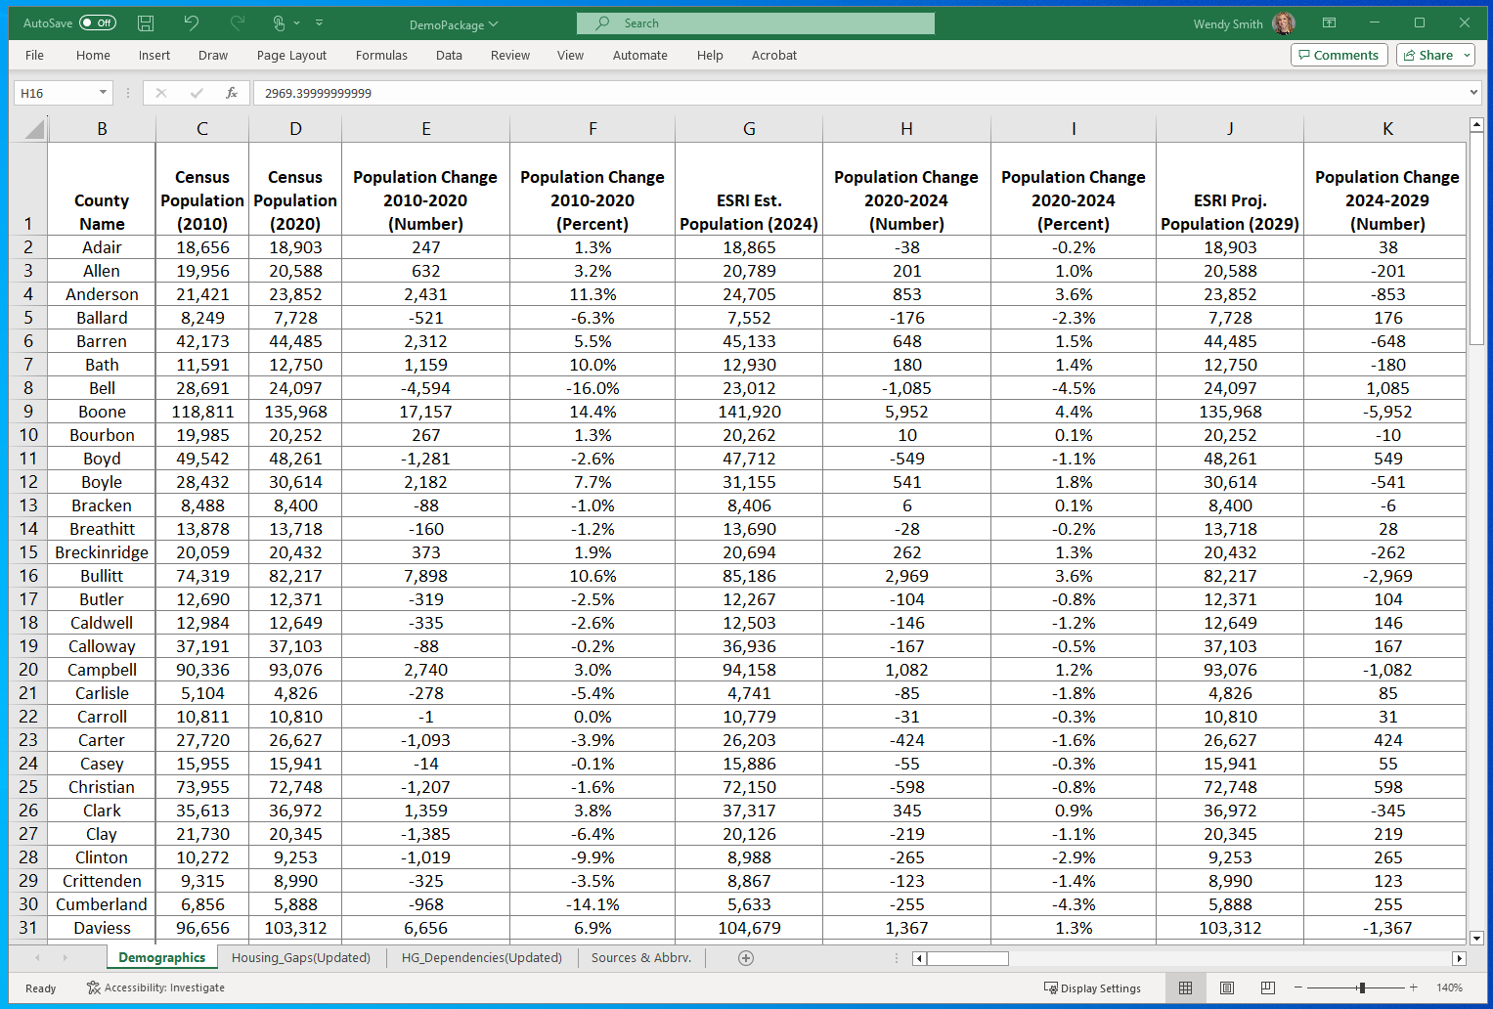
A LOT of raw data available online!
www.kyhousing.org/Data-Library/Housing-Gap-Analysis/Pages/Data.aspx

Slide 12
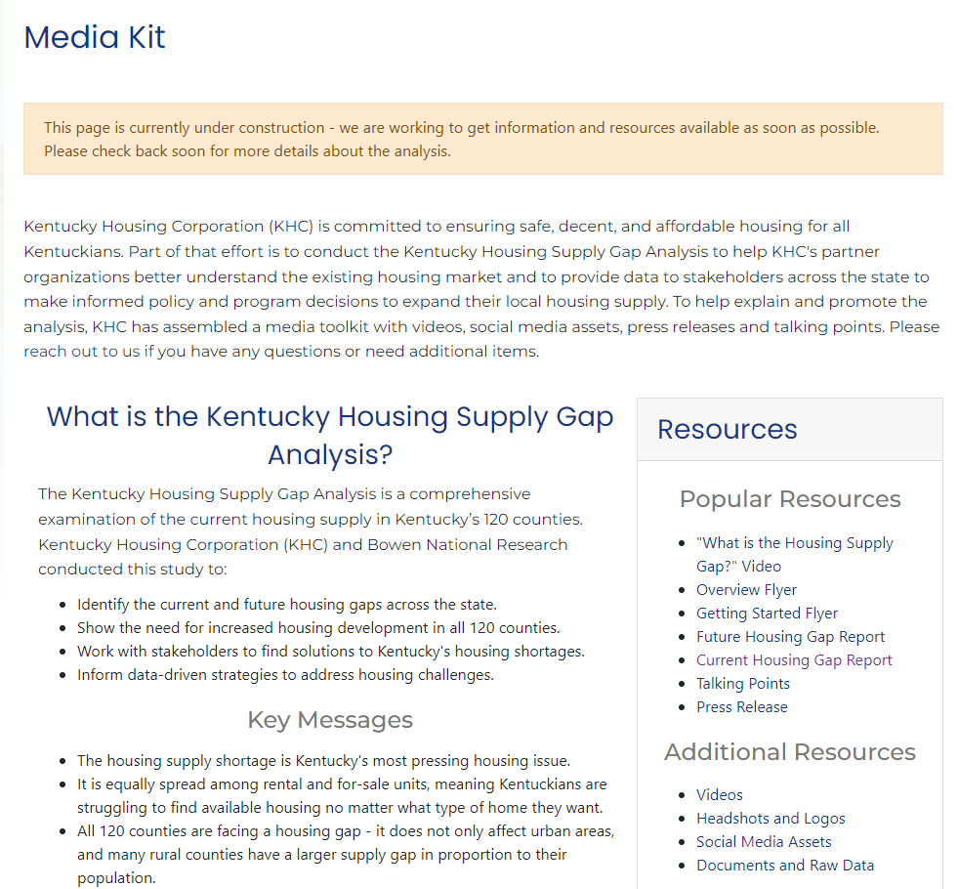
www.kyhousing.org/Data-Library/Housing-Gap-Analysis/Pages/Media-Kit.aspx

Slide 13
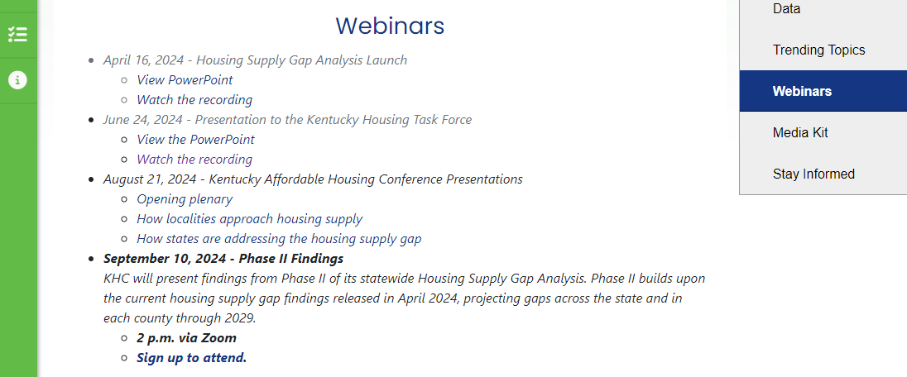
www.kyhousing.org/Data-Library/Housing-Gap-Analysis/Pages/Webinars.aspx

Slide 14
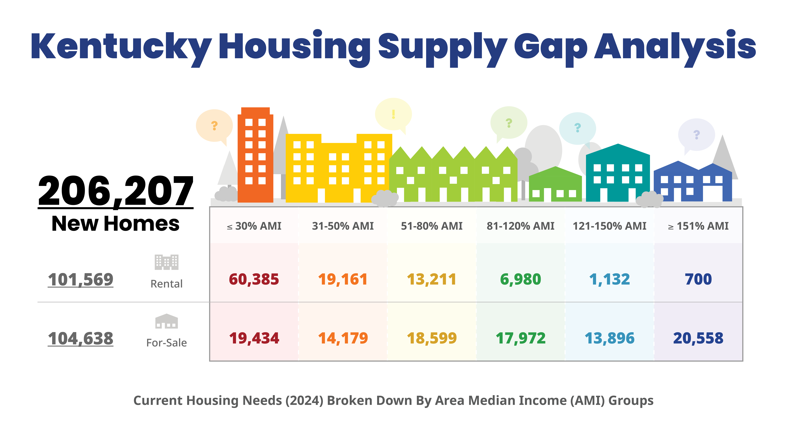
Phase I:
Current Gaps

Slide 15
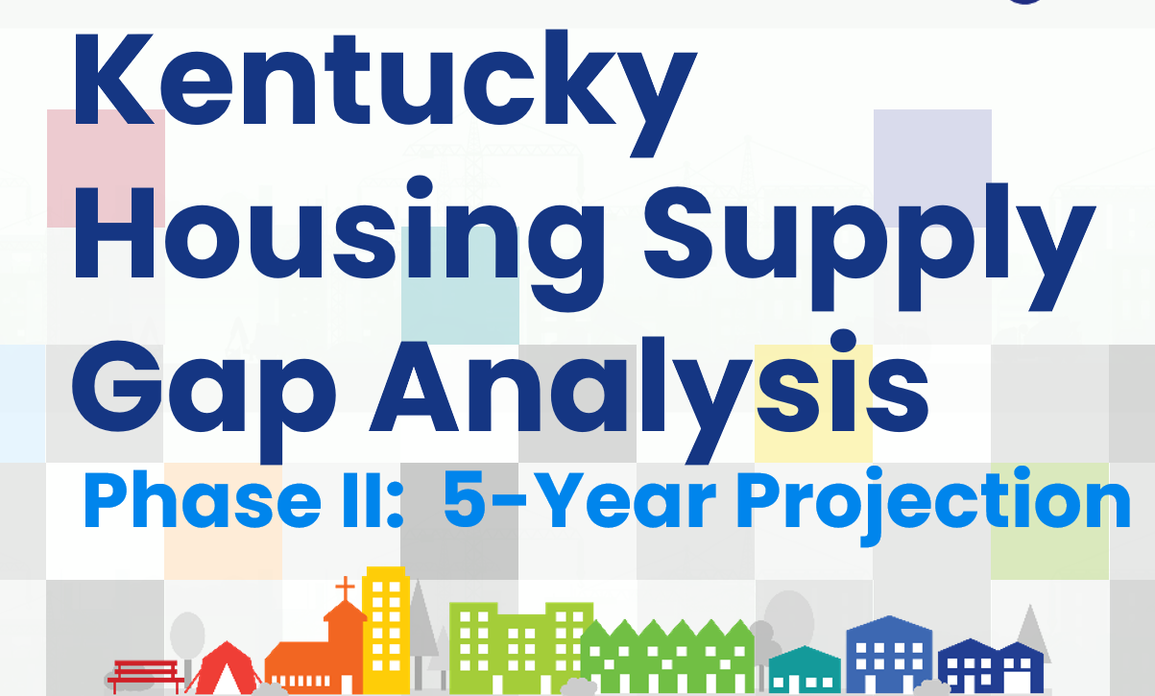

Slide 16
BOWEN PRESENTATION

Slide 17
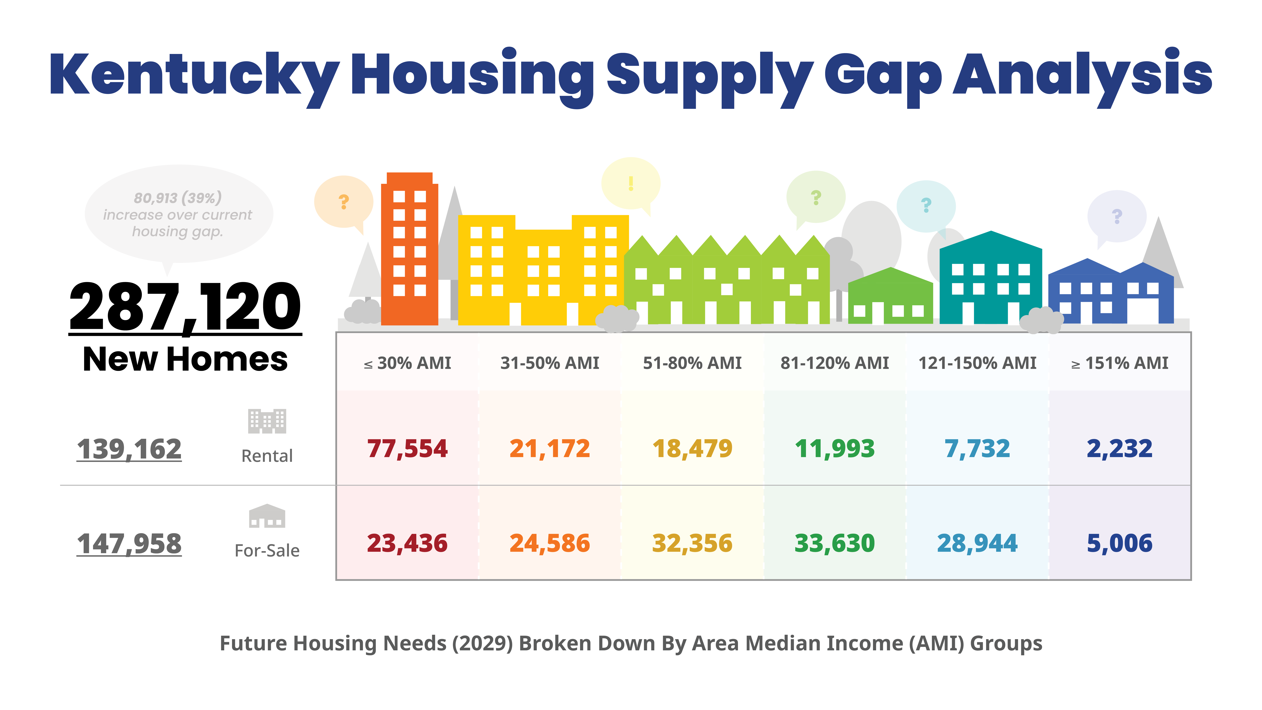
Phase II: 2029 Gaps
Notes:
Why Did KHC Commission a Housing Supply Gap Analysis?
KHC’s own programs are having a hard time serving low- & moderate-income Kentuckians because the Commonwealth doesn’t have enough housing:
Moderate-income homebuyers can’t find affordable homes.
Very low-income tenants with rent assistance can’t find reasonably price apartments that will accept a voucher.
Kentuckians are experiencing homelessness for the first time at higher rates, and unsheltered homelessness is increasing.
Middle, moderate, and low-income households are competing for the same units.
KHC has heard from leaders and partners across Kentucky that they need more housing for middle, moderate & low-income households.
Phase 1: Current supply gap (released April 16)
Phase 2: 5-year gap projection (August 21)

Slide 18
    Lower average housing costs.
    Higher homeownership rates.
    More workforce housing.
    Lower eviction rates.
    Fewer homeless Kentuckians.
    Increased household stability.
If Kentucky had enough housing units, we’d see:
The housing supply shortage
is Kentucky’s most urgent housing issue.

Slide 19
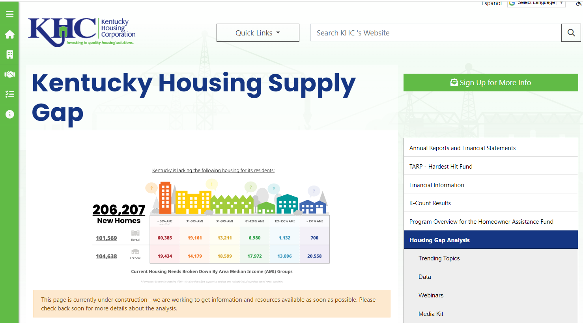
Visit the webpage: kyhousing.org/Data-Library/Housing-Gap-Analysis/Pages/default.aspx

Slide 20


PHASE II: HOUSING SUPPLY GAP ANALYSIS
(2024 and 2029 Estimates)
Commonwealth of Kentucky
Prepared For:
September KHC Webinar
Presented & Prepared by: Patrick Bowen
patrickb@bowennational.com
614-833-9300

Slide 21
Kentucky’s
Demographic Background
The various demographic metrics are considered in this analysis including key population and household attributes for each county are provided for various historical points in time, as well as current (2024) and projected (2029).

Slide 22
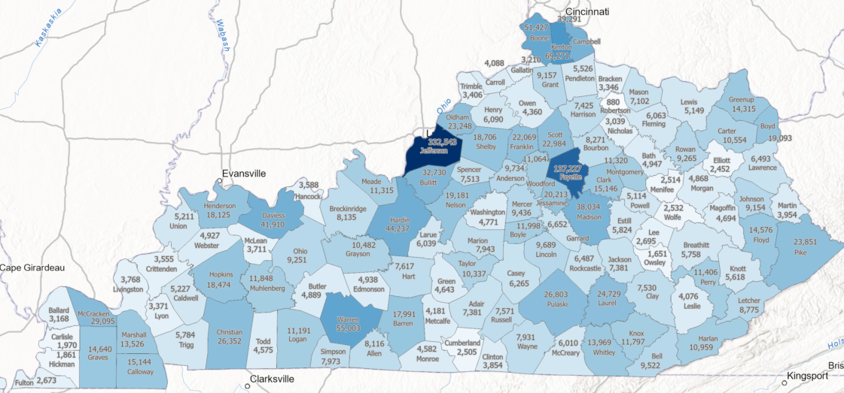

Total Households (2024)

Slide 23
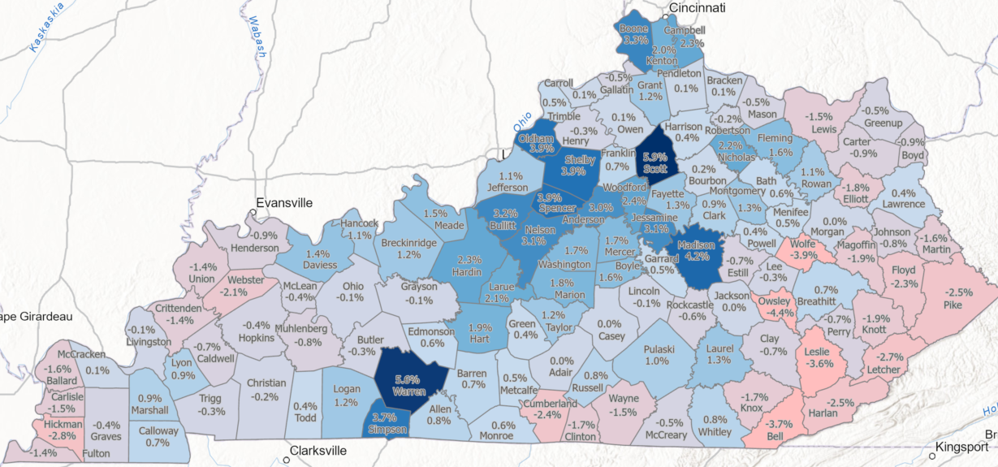

Percent Change Total Households (2024 to 2029)

Slide 24
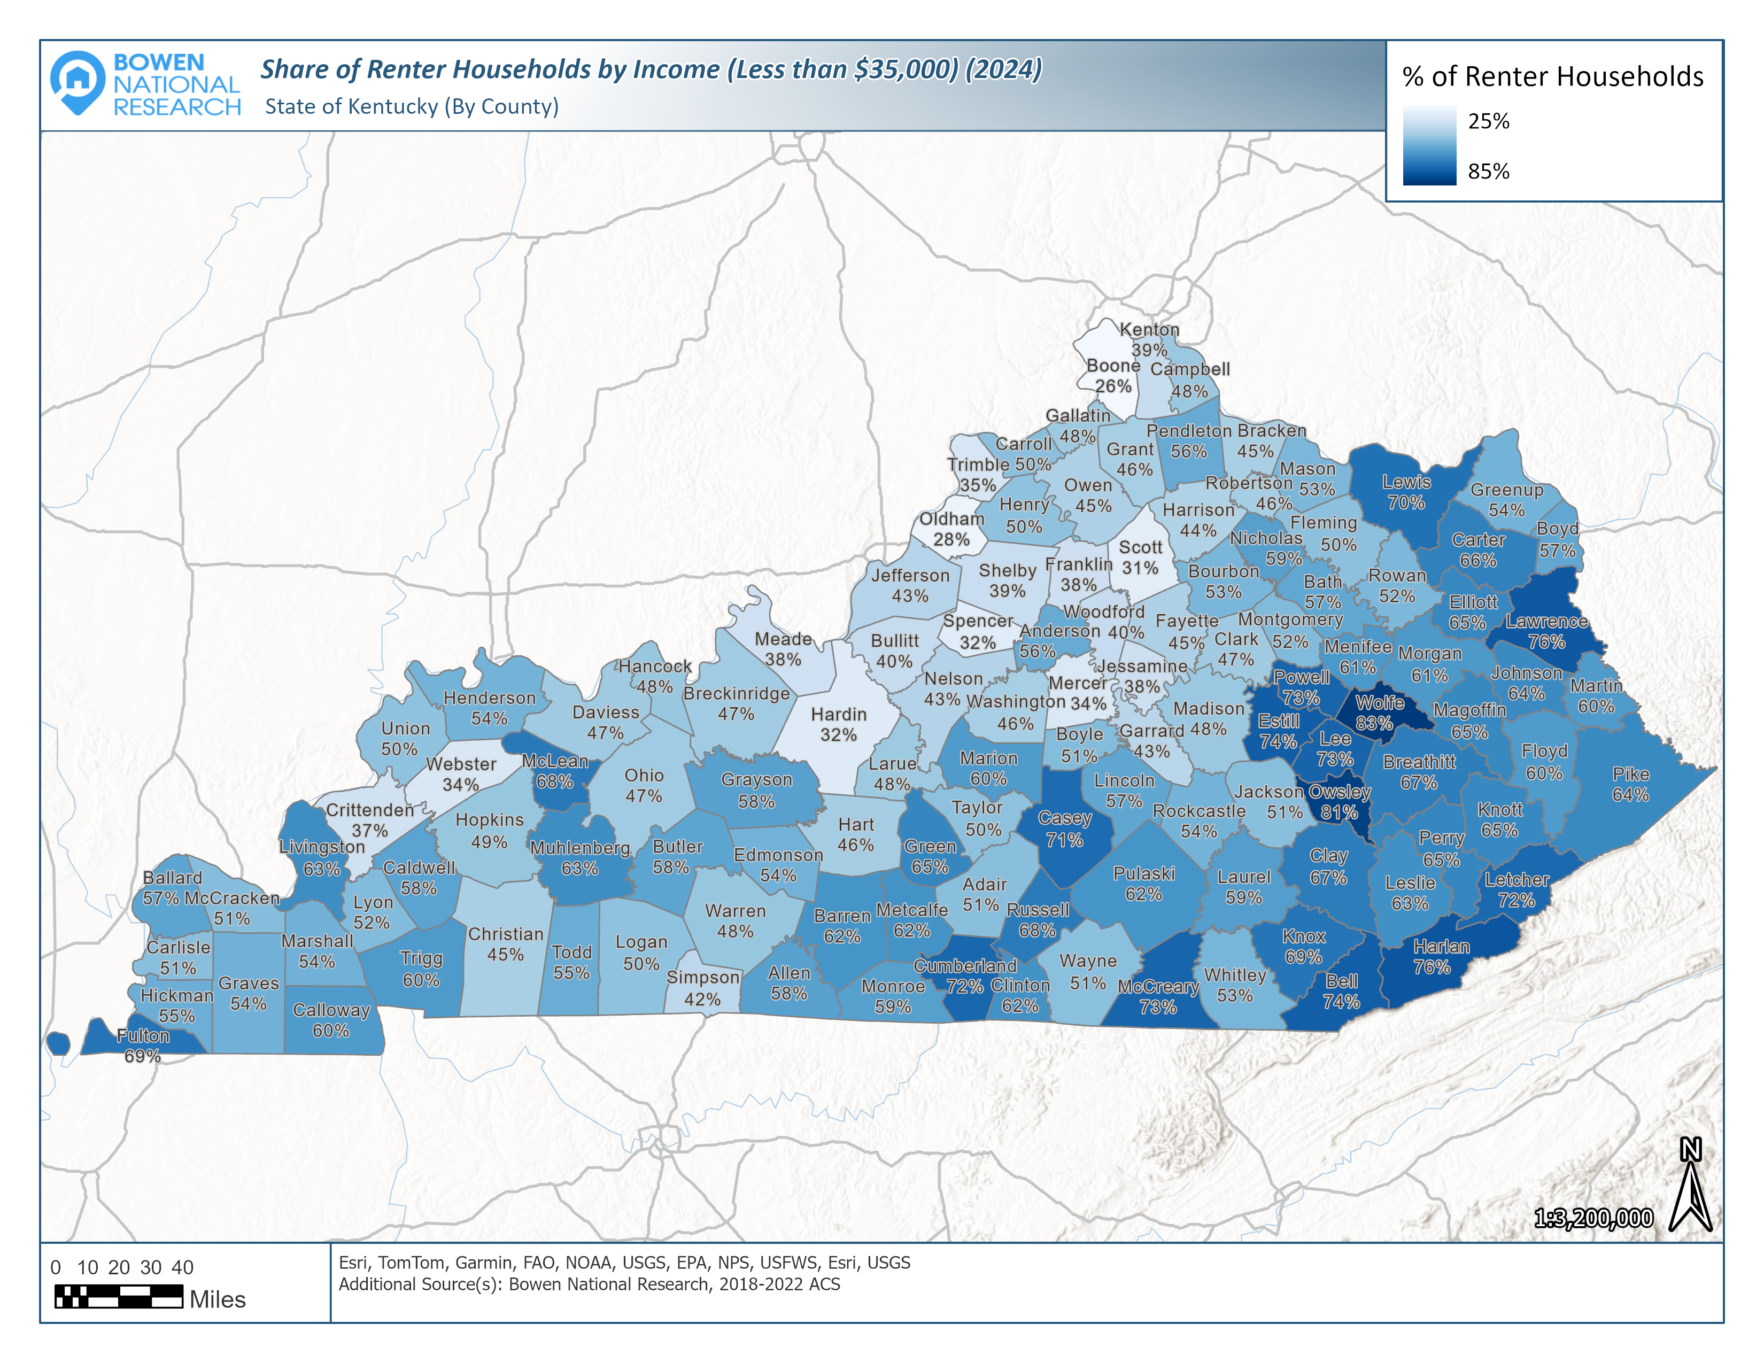
Share of Renter Households by Income (<$35k) - 2024

Slide 25
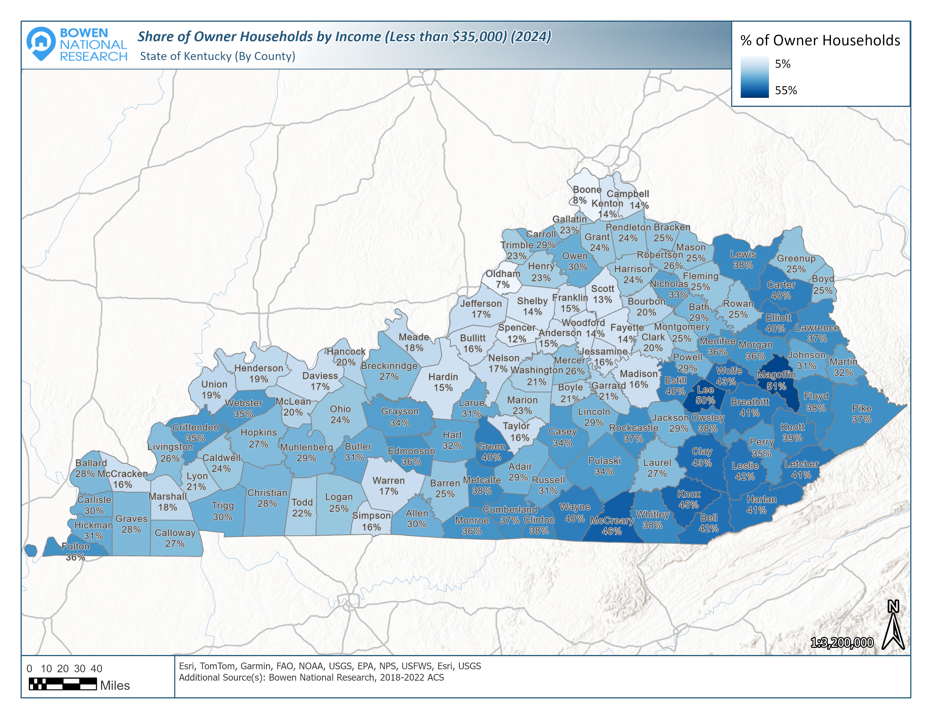
Share of Owner Households by Income (<$35k) - 2024

Slide 26
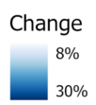
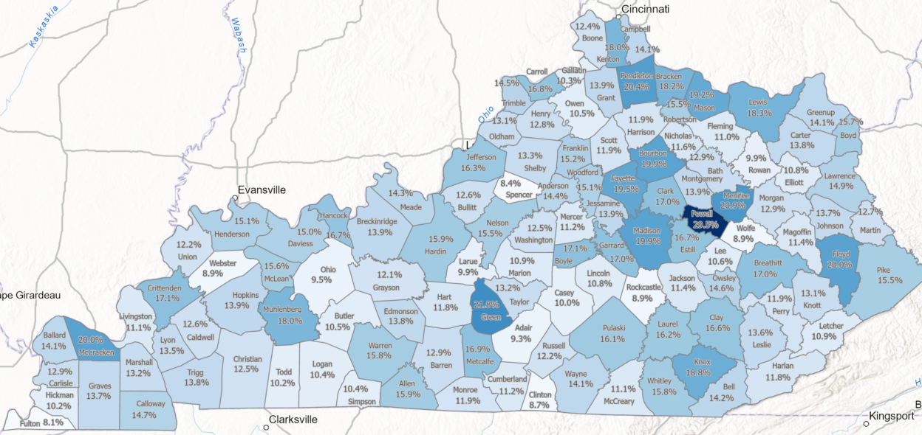
Median Income Percent Change (2024-2029)

Slide 27
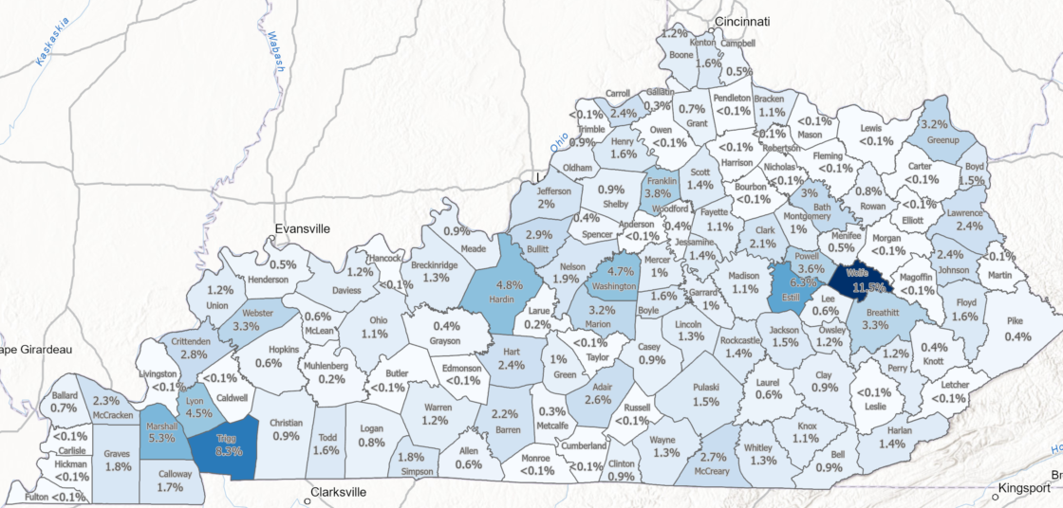
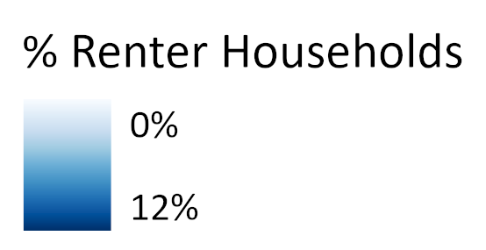
Substandard Rental Housing Share (2022)
Substandard housing is considered occupied housing lacking complete kitchens.

Slide 28
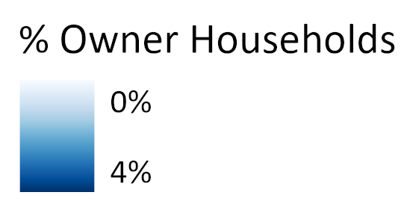
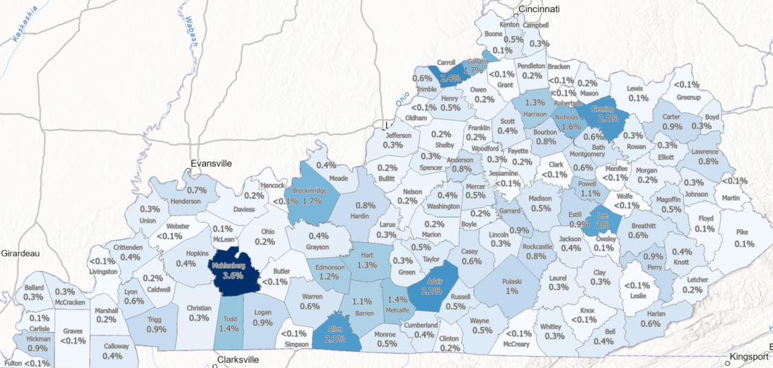
Substandard Owner Housing Share (2022)
Substandard housing is considered occupied housing lacking complete kitchens.

Slide 29
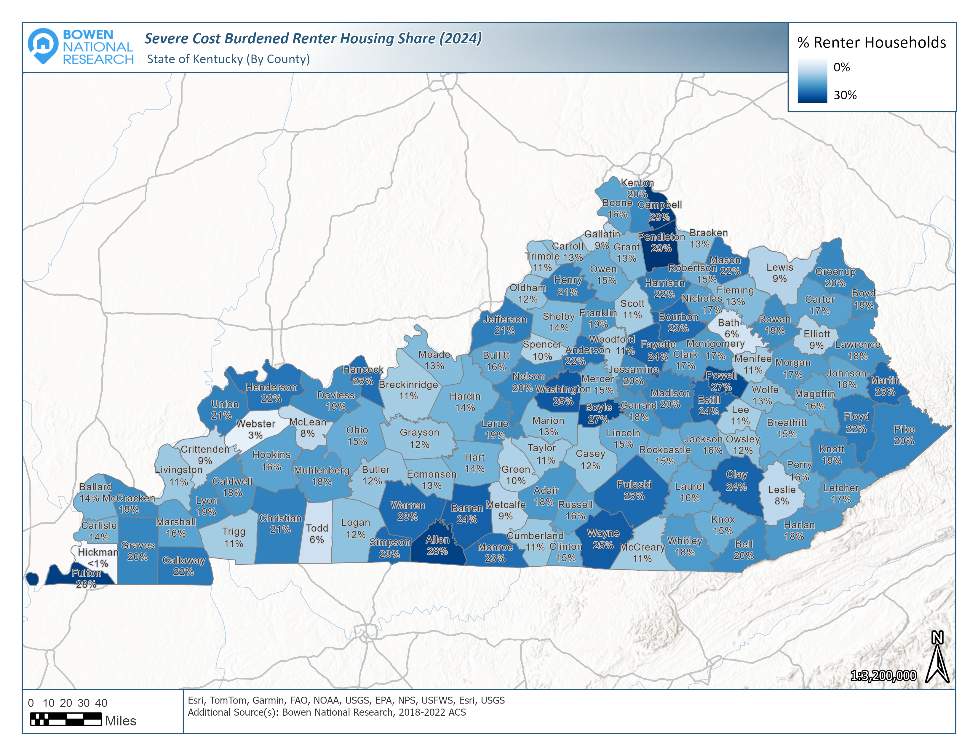
Severe Cost Burdened Renter Housing Share (2022)
Severe housing cost burdened households are those paying over 50% of their income towards housing costs.

Slide 30
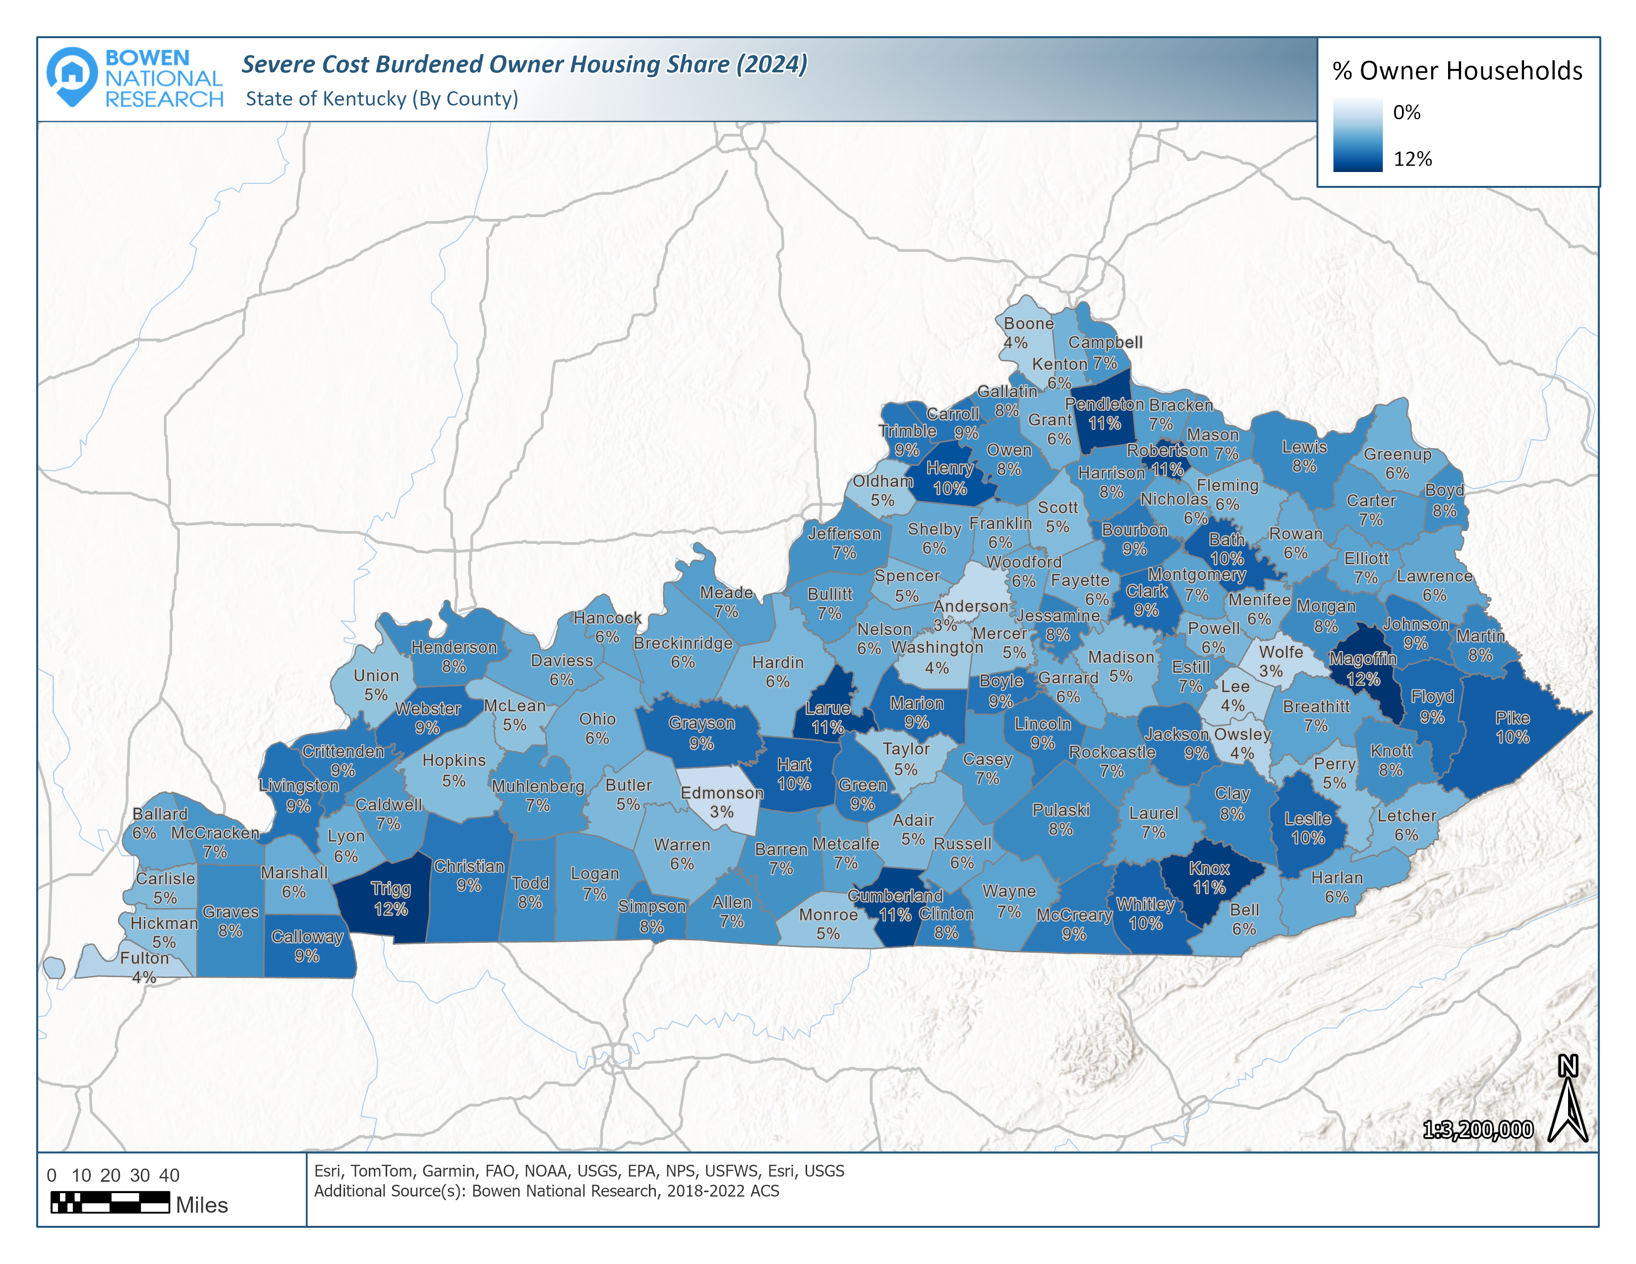
Severe Cost Burdened Owner Housing Share (2022)
Severe housing cost burdened households are those paying over 50% of their income towards housing costs.

Slide 31
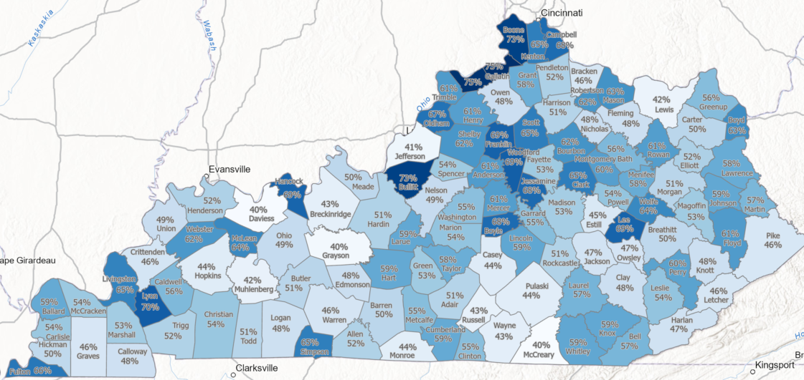

In-Commuter to Total Employment Ratio (2021)
The ratio of in-commuters to persons employed in each county was derived to provide scale of in-commuter influence.

Slide 32
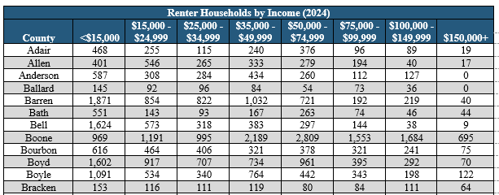
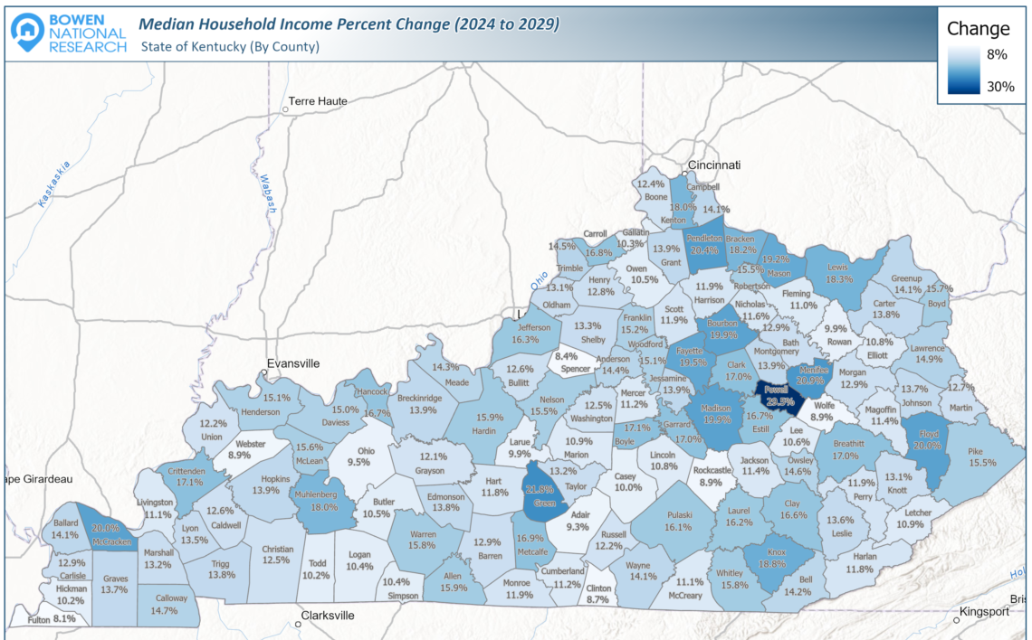
Demographic Data Available on County Level
Available Housing Data:
Total Population
Population Density
Population Marital Status
Population by Educational Attainment
Population Poverty Rate
Total Households
Households by Age
Households by Tenure (Renter vs. Owner)
Households by Median Income
Households by Tenure and Income
Households Living in Substandard Housing
Severe Housing Cost Burdened Households
Population Commuting into Counties
Annual Turnover Rate by Tenure

Slide 33
Multifamily Rental Housing Overview
A total of 1,209 multifamily rental projects were surveyed in the state totaling 107,614 units.
Surveyed Multifamily Rental Housing Units - Kentucky
Project Type | Projects Surveyed | Total Units | Vacant Units | Occupancy Rate | Vacancy Rate
Market-Rate | 498 | 68,773 | 2,400 | 96.5% | 3.5%
Market-Rate/Tax Credit | 8 | 807 | 1 | 99.9% | 0.1%
Market-Rate/Government-Subsidized | 16 | 1,200 | 0 | 100.0% | 0.0%
Tax Credit | 205 | 11,731 | 307 | 97.4% | 2.6%
Tax Credit/Government-Subsidized | 193 | 9,408 | 59 | 99.4% | 0.6%
Government-Subsidized | 287 | 15,378 | 103 | 99.3% | 0.7%
Market-Rate/Tax Credit/Gov.-Subsidized | 2 | 317 | 0 | 100.0% | 0.0%
Total | 1,209 | 107,614 | 2,870 | 97.3% | 2.7%
All project types are operating at vacancy rates of 3.5% or lower, which is below the range of 4%-6% for a typically healthy market.

Slide 34
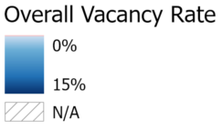
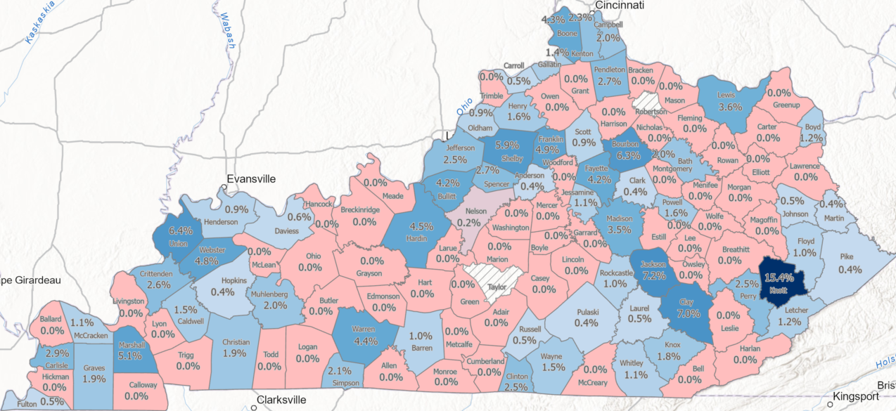
Overall Multifamily Rental Vacancy Rates
Vacancy rates established from survey of apartments in first half of 2024. Healthy, well-balanced rental markets typically operate with vacancy rates between 4%-6%.

Slide 35
Multifamily Rental Vacancies by Unit Type
While the vast majority (83.7%) of identified vacancies are among the market-rate supply, market-rate supply is operating at a 3.4% vacancy rate. There are only 469 vacant units among affordable (Tax Credit and Government-subsidized) supply.

Slide 36
Multifamily Rental Wait Lists by Unit Type
Significant Pent-up Demand Exists for Rental Housing
There are an estimated 15,255 households on wait lists for available units, with just over 11,000 for Government-subsidized units and over 3,200 for Tax Credit units.

Slide 37
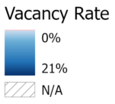
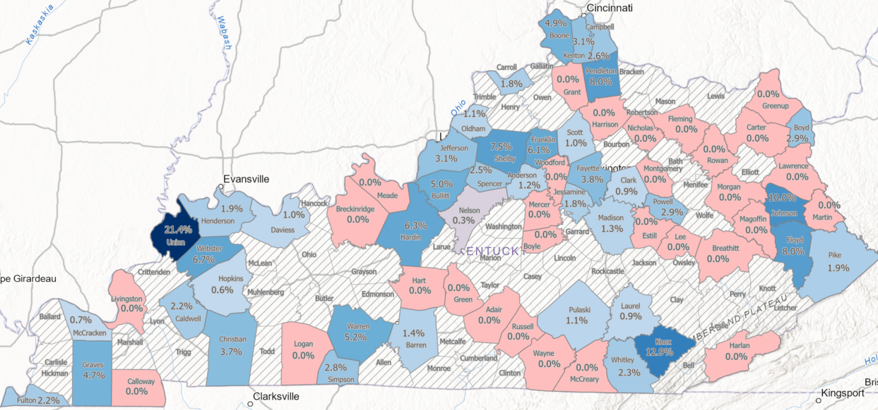
Market-Rate Multifamily Rental Vacancy Rates

Slide 38
Market-Rate Multifamily Rental Wait Lists
32 counties have wait lists among the surveyed market-rate supply. Five counties have wait lists of over 65 households. Overall, 1,000 households are on wait lists for available market-rate units.

Slide 39
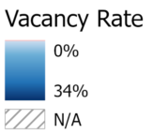
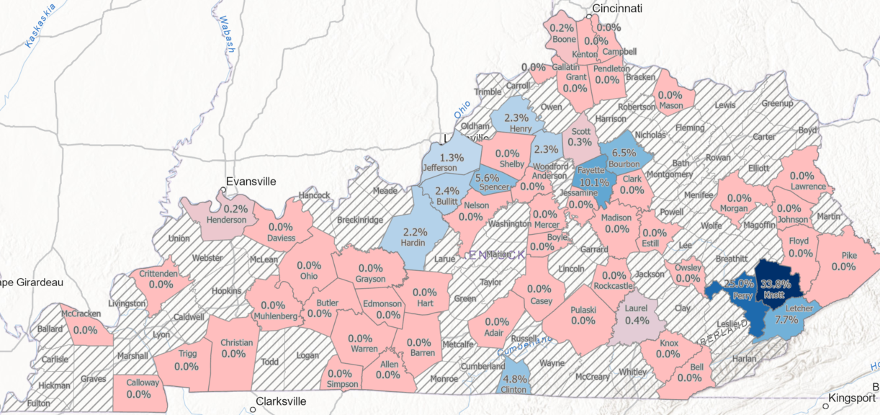
Tax Credit Multifamily Rental Vacancy Rates

Slide 40
Tax Credit Multifamily Rental Wait Lists
42 counties have wait lists among the surveyed Tax Credit supply. 16 counties have combined wait lists of over 60 households. Overall, 3,263 households are on wait lists for available Tax Credit units.

Slide 41
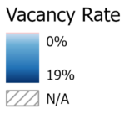
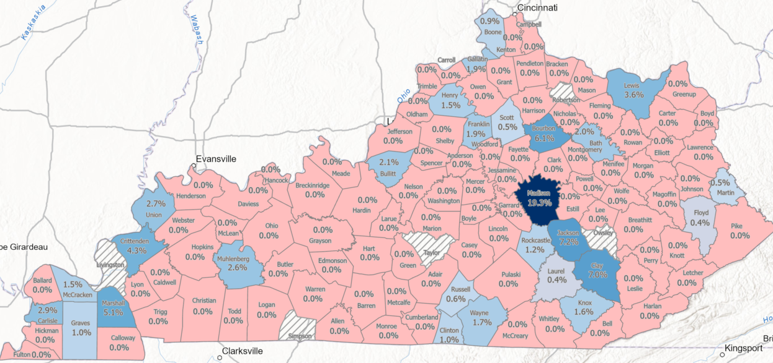
Subsidized Multifamily Rental Vacancy Rates

Slide 42
Subsidized Multifamily Rental Wait Lists
100 counties have wait lists among the surveyed Government Subsidized supply. 30 counties have wait lists of 120 or more households. Overall, more than 11,000 households are on wait lists for available government-subsidized units.

Slide 43
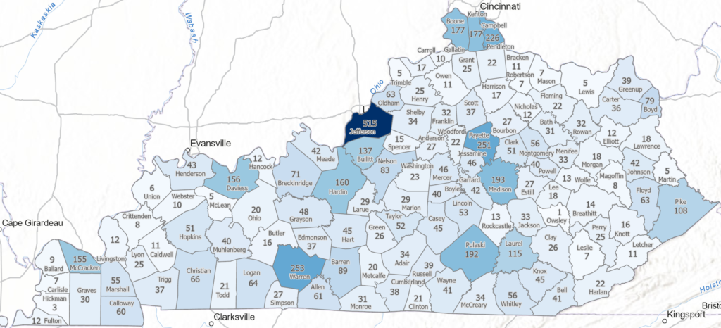

Total Available For-Sale Housing Units (2024)
Overall Kentucky Available For-Sale Housing Supply
Available Homes | Availability Rate | Median List Price
6,014 | 0.5% | $279,900

Slide 44
Available For-Sale Housing Supply
Only one county is operating at the optimal availability rate between 2%-3%. A total of 33 counties are operating at significantly low availability rates of under 0.4%.

Slide 45
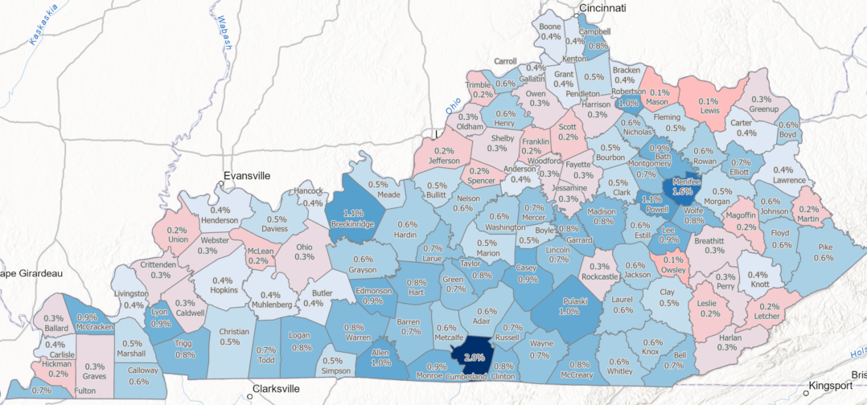

Share of Available For-Sale Housing Units (2024)
For-sale availability rates above 2% may be indicators of overbuilt markets or a housing surplus.

Slide 46
Available For-Sale Housing Supply
While the largest number of homes available to purchase are priced under $200,000, overall supply is well balanced by price point.
While nearly one-third of available supply is priced under $200,000, this is often in counties with average year built of pre-1960 or offer small average unit sizes (less than 1,300 square feet). These attributes often reflect product requiring additional costs to repair or maintain.

Slide 47
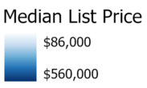
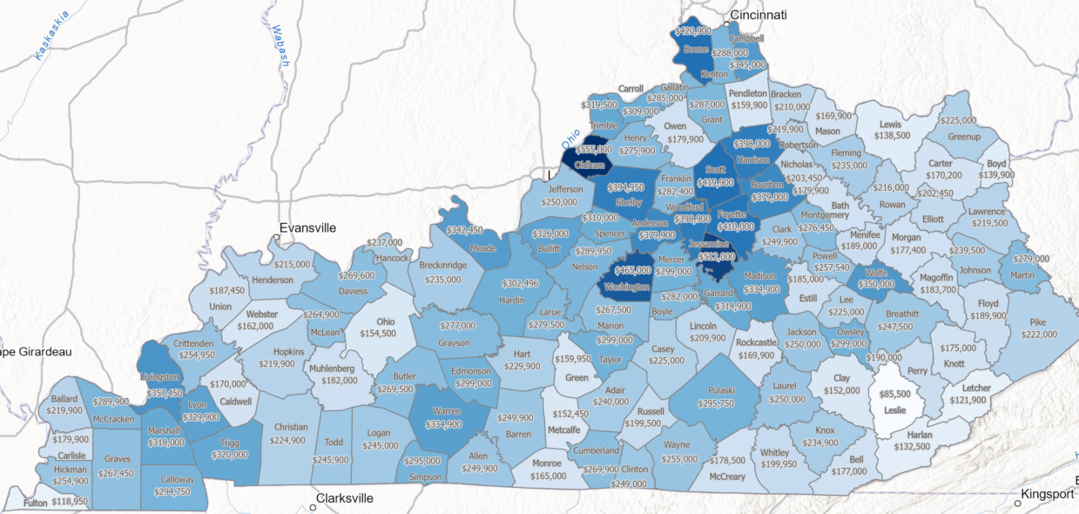
Median List Prices of Available Housing

Slide 48
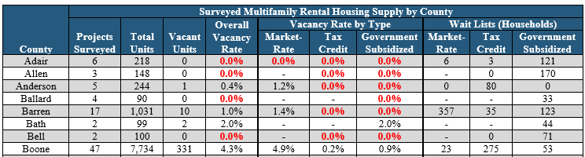
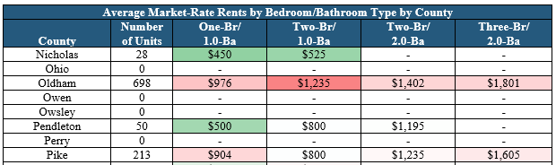
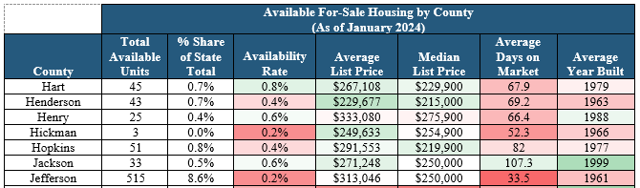
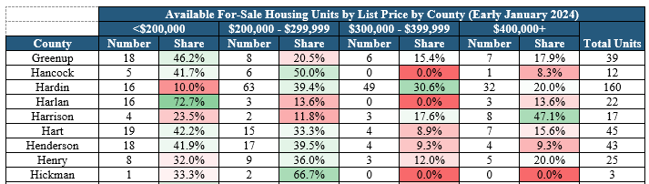
Housing Data Available on County Level
Numerous Data Points Available for Each County!
Available Housing Data:
Rental Units/Projects
Vacant Rentals
Wait List Totals
Average Rents
Available Homes
Median List Prices
Avg. Days on Market
Avg. Year Built
Breakdown of Price Ranges

Slide 49
Kentucky’s Housing Gaps
Current (2024) and Projected (2029) Housing Supply Gap Estimates
Gaps by Tenure (Renter vs. Owner)
Gaps by Household Income (Percent of Area Median Income)
  <30%
  31%-50%
  51%-80%
  81%-120%
  121%-150%
  151%+
Note: 2029 Household Income Ranges Adjusted to Account for Projected Growth in Median Household Incomes.
Gaps by Geography (County, Region/District, and State)
Gaps as Number of Units and as Ratio of Housing Gaps to Households

Slide 50
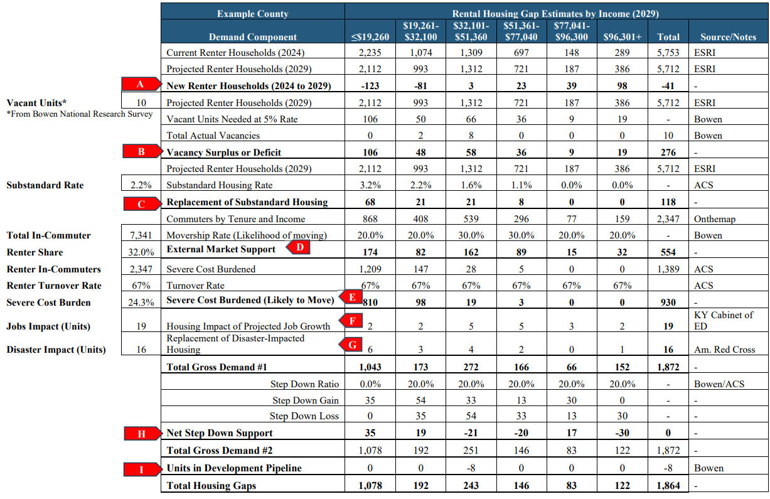
Housing Gap Estimates Methodology
Housing Gap Considerations:
Used HUD’s Published Income Limits by AMI
Assumed Four-Person Income Limits by AMI
Total Renter and Owner Households by Income
Households Living in Substandard Housing
Severe Housing Cost Burdened Households
In-Commuters (Commuters Likely to move closer to Where they Work)
Announced Job Growth Impact on Housing
Natural Disaster Impact on Housing
Step-Down Support (People Spending Less on Housing than what they can Afford)
Sources:
US Census
American Community Survey
ESRI (National Demographer)
Realtor.com
Bowen National Research
Sample Calculations
Note: Housing supply gap methodology differs from KHC site-specific market feasibility methodology

Slide 51
Overall Housing Gaps (2024)
Renter, Owner and Combined
Kentucky has an overall housing gap of 206,207 units, with the gap split relatively evenly between rental units (101,569 units, 49.3% of the overall statewide housing gap) and for-sale units (104,638 units, 50.7% of the overall statewide housing gap).
 |  | State of Kentucky (2024) Overall Housing Gaps (by Tenure and Area Median Income)
 |  | Number of Units Needed by Household Income Level |  |  |  |  |  | Total Gap
 |  | ≤30% | 31%-50% | 51%-80% | 81%-120% | 121%-150% | 151%+ | Total Units | Share of State
Rental Gaps | Units | 60,385 | 19,161 | 13,211 | 6,980 | 1,132 | 700 | 101,569 | 49.3%
 | Share | 59.4% | 18.9% | 13.0% | 6.9% | 1.1% | 0.7% | 100.0% | -
For-Sale Gaps | Units | 19,434 | 14,179 | 18,599 | 17,972 | 13,896 | 20,558 | 104,638 | 50.7%
 | Share | 18.5% | 13.6% | 17.8% | 17.2% | 13.3% | 19.7% | 100.0% | -
State Total | Units | 79,819 | 33,340 | 31,810 | 24,952 | 15,028 | 21,258 | 206,207 | 100.0%
 | Share | 38.7% | 16.2% | 15.4% | 12.1% | 7.3% | 10.3% | 100.0% | -

Slide 52
Overall Housing Gaps (2029)
Renter, Owner and Combined
By 2029, Kentucky’s overall housing gap is expected to increase to 287,120 units, with the gap still split relatively evenly between rental units (139,162 units, 48.5% of the overall statewide housing gap) and for-sale units (147,958 units, 51.5% of the overall statewide housing gap).
 |  | State of Kentucky (2029) Projected Overall Housing Gaps (by Tenure and Area Median Income)
 |  | Number of Units Needed by Household Income Level |  |  |  |  |  | Total Gap
 |  | ≤30% | 31%-50% | 51%-80% | 81%-120% | 121%-150% | 151%+ | Total Units | Share of State
Rental Gaps | Units | 77,554 | 21,172 | 18,479 | 11,993 | 7,732 | 2,232 | 139,162 | 48.5%
 | Share | 55.7% | 15.2% | 13.3% | 8.6% | 5.6% | 1.6% | 100.0% | -
For-Sale Gaps | Units | 23,436 | 24,586 | 32,356 | 33,630 | 28,944 | 5,006 | 147,958 | 51.5%
 | Share | 15.8% | 16.6% | 21.9% | 22.7% | 19.6% | 3.4% | 100.0% | -
State Total | Units | 100,990 | 45,758 | 50,835 | 45,623 | 36,676 | 7,238 | 287,120 | 100.0%
 | Share | 35.2% | 15.9% | 17.7% | 15.9% | 12.8% | 2.5% | 100.0% | -

Slide 53
Overall Housing Gap by Area Median Income (2024 & 2029)
Renter and Owner Combined
The largest overall housing gaps by AMI level in 2024 and 2029 are among product that is affordable to households earning up to 30% of AMI. Housing gaps for housing affordable to households earning up to 80% of AMI represents approximately 70% of the overall state’s gap.

Slide 54
Rental Housing Gap by Area Median Income
The greatest rental housing gap is for the most affordable product, units affordable to households earning at or below 30% of Area Median Income (AMI). Rental housing gaps are expected to increase at all AMI levels.

Slide 55
For-Sale Housing Gap by Area Median Income
The for-sale housing gaps are distributed relatively even among the different affordability levels and are expected to increase among most income levels.

Slide 56
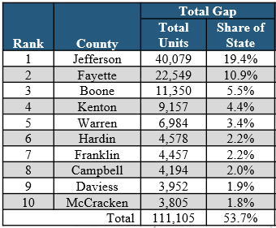
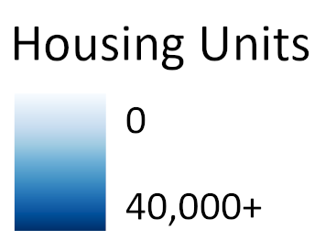
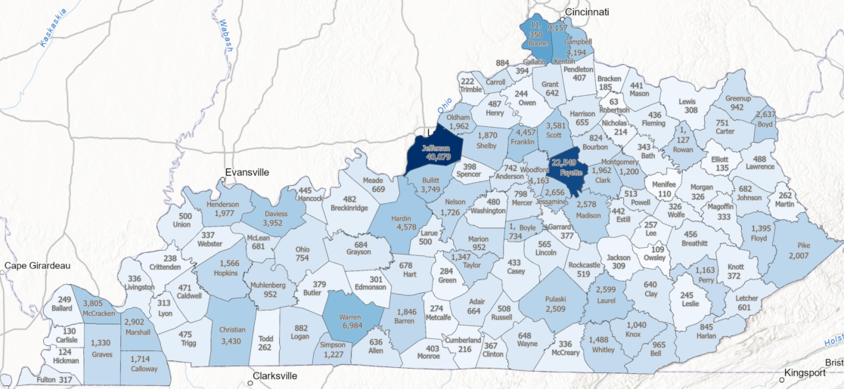
Overall Housing Gaps (Number of Units) by County (2024)
Renter & Owner Combined

Slide 57
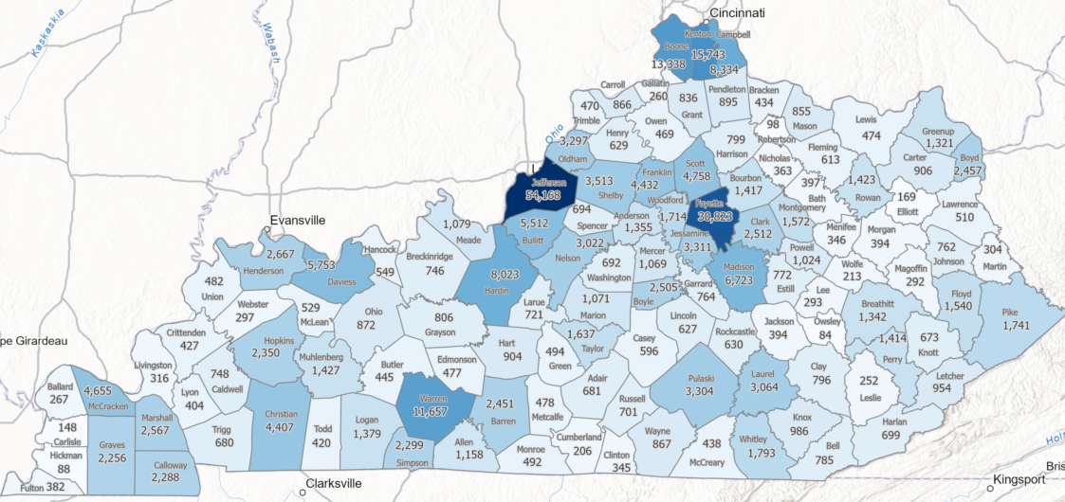


Overall Housing Gaps (Number of Units) by County (2029)
Renter & Owner Combined

Slide 58


Overall Housing Gap to Total Households Ratio (2024)
Renter & Owner Combined

Slide 59



Overall Housing Gap to Households Ratio (2029)
Renter & Owner Combined

Slide 60

Rental Housing Gaps (2024)
Rank | County | Total Gap
1 | Jefferson | 21,575
2 | Fayette | 14,423
3 | Kenton | 4,815
4 | Boone | 4,425
5 | Warren | 4,388
6 | Franklin | 2,507
7 | Hardin | 2,320
8 | McCracken | 2,288
9 | Christian | 2,254
10 | Campbell | 1,951

Slide 61



Rental Housing Gaps (2029)

Slide 62

Rental Housing Gap to Rental Households Ratio (2024)
Rank | County | Rental Households | Total Gap | Gap to Units Ratio
1 | Marshall | 2,545 | 977 | 38.4%
2 | Boone | 12,087 | 4,425 | 36.6%
3 | Franklin | 7,811 | 2,507 | 32.1%
4 | Carroll | 1,384 | 436 | 31.5%
5 | McLean | 750 | 221 | 29.5%
6 | Wolfe | 883 | 233 | 26.4%
7 | Scott | 6,720 | 1,671 | 24.9%
8 | Simpson | 2,816 | 697 | 24.7%
9 | Fayette | 60,447 | 14,423 | 23.9%
10 | Clark | 4,755 | 1,052 | 22.1%

Slide 63


Rental Housing Gap to Renter Households Ratio (2029)
Rank | County | Rental Households | Total Gap | Gap/HH Ratio
1 | Simpson | 2,852 | 1,326 | 46.5%
2 | Boone | 12,805 | 5,702 | 44.5%
3 | Boyle | 3,841 | 1,369 | 35.6%
4 | Marshall | 2,524 | 881 | 34.9%
5 | Carroll | 1,370 | 442 | 32.3%
6 | Powell | 1,501 | 479 | 31.9%
7 | Washington | 1,119 | 351 | 31.4%
8 | Breathitt | 1,560 | 485 | 31.1%
9 | Franklin | 7,765 | 2,397 | 30.9%
10 | Campbell | 11,874 | 3,539 | 29.8%

Slide 64

For-Sale Housing Gaps (2024)
Rank | County | Total Gap
1 | Jefferson | 18,504
2 | Fayette | 8,126
3 | Boone | 6,925
4 | Kenton | 4,342
5 | Warren | 2,596
6 | Bullitt | 2,558
7 | Hardin | 2,258
8 | Campbell | 2,243
9 | Daviess | 2,109
10 | Franklin | 1,950

Slide 65



For-Sale Housing Gaps (2029)

Slide 66

For-Sale Housing Gap to Owner Households Ratio (2024)
Rank | County | Owner Households | Total Gap | Gap/HH Ratio
1 | Boone | 39,340 | 6,925 | 17.6%
2 | Marshall | 10,981 | 1,925 | 17.5%
3 | Carroll | 2,704 | 448 | 16.6%
4 | McLean | 2,961 | 460 | 15.5%
5 | Franklin | 14,258 | 1,950 | 13.7%
6 | Scott | 16,264 | 1,910 | 11.7%
7 | Boyle | 8,164 | 911 | 11.2%
8 | Gallatin | 2,343 | 249 | 10.6%
9 | Fayette | 76,780 | 8,126 | 10.6%
10 | Hancock | 2,872 | 303 | 10.6%

Slide 67


For-Sale Housing Gap to Owner Households Ratio (2029)
Rank | County | Owner Households | Total Gap | Gap/HH Ratio
1 | Kenton | 47,596 | 9,682 | 20.3%
2 | Breathitt | 4,239 | 857 | 20.2%
3 | Boone | 40,325 | 7,636 | 18.9%
4 | Simpson | 5,418 | 973 | 18.0%
5 | Campbell | 28,338 | 4,795 | 16.9%
6 | Fayette | 78,677 | 12,890 | 16.4%
7 | Scott | 17,331 | 2,709 | 15.6%
8 | Shelby | 14,062 | 2,197 | 15.6%
9 | Carroll | 2,724 | 424 | 15.6%
10 | Marshall | 11,120 | 1,686 | 15.2%

Slide 68


Housing Gaps for Area Development Districts
Housing gaps provided for each of KY’s 15 Area Development Districts, including tenure, time period, and affordability level.
Rental Housing
For-Sale Housing

Slide 69
Factors Influencing Rental Housing Gaps
Rental Gap Share by Demand Factor
Kentucky’s overall rental housing gaps are most influenced by household growth (35%) and households that are severe cost burdened (33.4%).

Slide 70
Factors Influencing For-Sale Housing Gaps
For-Sale Gap Share by Demand Factor
Nearly two-thirds of the state’s overall for-sale housing gaps is attributed to household growth, followed by units required for a balanced/healthy market (20.1%).

Slide 71
What Housing Gaps are and What They are Not
Housing gaps demonstrate the housing market shortages or needs and are not necessarily reflective of market potential.
An individual county with no or minimal housing gaps within a specific price range doesn't mean a new project can't be supported.
Product Design
Recommended that site-specific studies are conducted for individual projects!
Gaps do not necessarily represent the number of units that need built, as a portion of the gaps are also reflective of units that need repaired or modernized or households paying excessive amounts towards housing that need assistance.
Housing gaps provided in this report are intended to give the public a sense of the degree of housing needs by the type of product and affordability levels. Ultimately, gap estimates provide quantified information to help prioritize housing efforts.
Market Areas
Target Market
Target Incomes
Property Location
Economic Investment & New Jobs

Slide 72


Contacts
Bowen National Research
155 East Columbus Street, Suite 220
Pickerington, Ohio 43147
Phone: 614-833-9300
Email: patrickb@bowennational.com
Website: www.bowennational.com
Kentucky Housing Corporation
1231 Louisville Road
Frankfort, Kentucky 40601
Phone: 502-564-7630
Email: wsmith@kyhousing.org
Website: https://www.kyhousing.org

